Slide 1
TRACFONE & MARKETSOURCE presents Mobile Concierge for Kroger

Slide 2
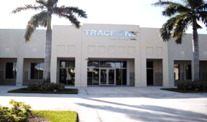
History of TracFone Wireless Inc.
1. TracFone Wireless Inc. is the #1 Prepaid Wireless provider in the U.S.
2. Established in 1996, was the first no-contract wireless MVNO in the U.S.
3. They introduced pay-as-you-go wireless service with no contracts, no bills and no hidden fees.

Slide 3
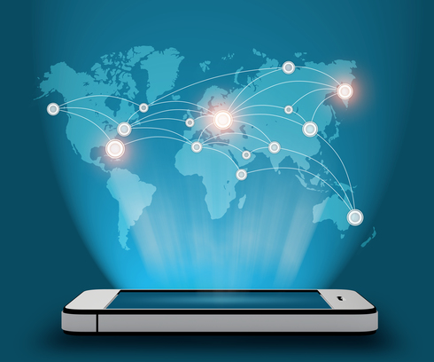
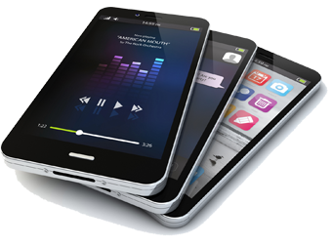
4. Is a subsidiary of America Móvil, the 4th largest wireless company in the world with over 284 million wireless subscribers.
5. Today TracFone Wireless, Inc. is America’s largest prepaid provider.

Slide 4
6. And 5th largest overall provider in the U.S. with 10 brands and over 26.5 Million customers.

Slide 5
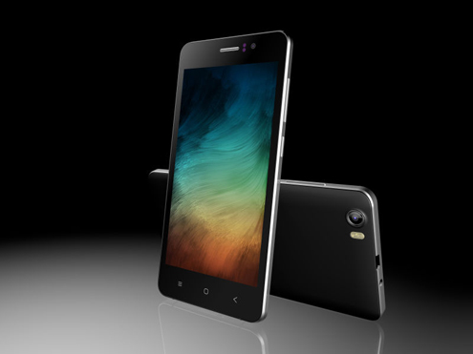
What do the Brands have in common?
3G and 4G LTE Speeds where available
No Contract, No Credit Check, No Activation Fees
No Roaming Fees or Cancellation Fees
Customers can keep their phone number or get a new one
Nationwide Coverage on America’s Best Networks
Customers can choose a brand that best fits their price and coverage needs
International Calling Plans
Flexibility to switch plans

Slide 6
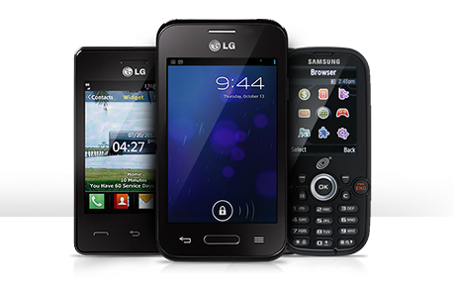
Why TracFone Wireless, Inc.
With a choice of 4 brands sold at Kroger, using the 4 largest Carriers, we are the only company that offers a wireless solution to most customers.
Same Networks - We’ve partnered with the country’s top carriers to bring you the same dependable coverage they offer through the same network of cellular towers, so you pay less for cell phone service and sacrifice nothing.
Same Phones - Popular models by LG, Samsung, Alcatel and ZTE. We offer the phones your customer wants.
Huge Savings – From Pay-As-You-Go or low Data usage to Unlimited Monthly options.

Slide 7
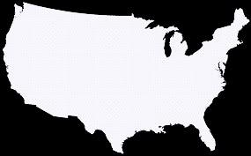
What are the 2 main technologies for phones?
GSM
Global System for Mobile communication used by
AT&T and T-Mobile
CDMA
Code Division Multiple Access used by Verizon and Sprint
Vs.
Differences between the two technologies include:
How voice data changes into radio waves
How the carrier connects to the phone
Coverage area
Data transfer speeds
Type of hardware used

Slide 8
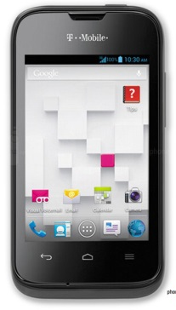
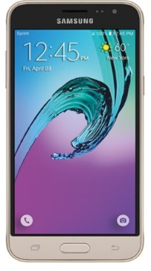
Network Carrier by Brand
Bolded brands are located at Kroger
T-Mobile | Sprint | AT&T | Verizon
Simple Mobile NET10 TracFone Telcel GoSmart Mobile SafeLink Wireless | NET10 | NET10 TracFone SafeLink Wireless | NET10 TracFone Total Wireless Page Plus SafeLink Wireless

Slide 9
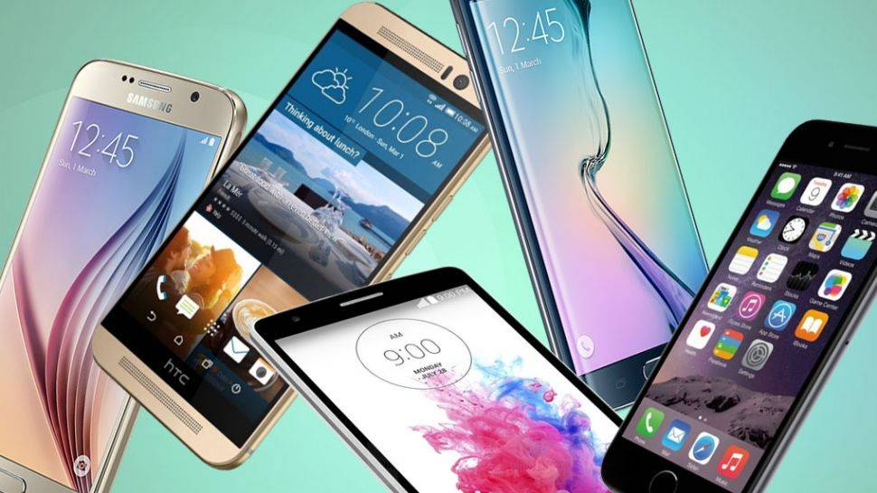
Brands in Focus

Slide 10
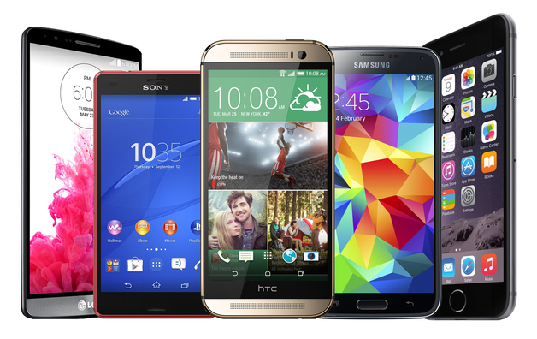
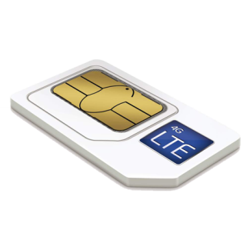
They are….
*Coming to Kroger June 1st
Free SIM with all BYOP activations

Slide 11
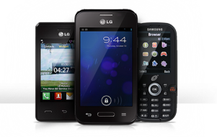
Mobile Concierge’s Role
First and foremost, the Ambassador’s role is to make a sale! Everything else is secondary.
Engage the customer. Probe and ask questions about the customers monthly cell phone usage; Talk, Text and Data to determine what brand best suits their needs.
Probe and ask questions about the style and specific features of a cell phone your customer is most interested in. Smartphone, Basic phone, Android, Apple?
Educate the customer on what brand best suits their needs and why.
Make the sale.
Thank the customer for their time and to have a nice day or to see them back again soon.

Slide 12
The Young, Hip, Informed, Techy Trendsetter

Slide 13
Target Audience
First to use newest technology when it emerges
Savvy user, uses Wi-Fi as much as possible for managing data usage
Customers who want Unlimited High Speed Data without throttling (available online only)
For BYOP, those who have a compatible
T-Mobile/AT&T or unlocked GSM phone

Slide 14
5 Airtime Plans
You get Unlimited Talk, Text and High Speed Data in the U.S. and Mexico with no roaming charges
Plans include Unlimited International Calling to Select Destinations (with up to 15 unique numbers per 30-Day Plan cycle)
Unlimited Calls and Texts from Mexico with no roaming charges
Unlimited & ILD $25
Unlimited & ILD 4GB $40
Unlimited & ILD 5GB $50
Unlimited and ILD $55 Unlimited & ILD $60
5 Handset Options
Z232
798
ZTE 861
LG57BL
S550

Slide 15
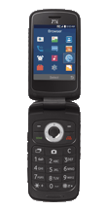
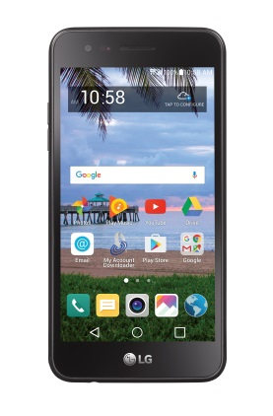
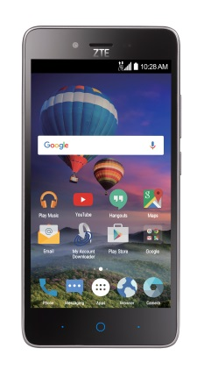
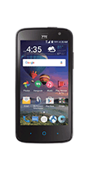
Plans & Phones Overview
Unlimited Plans
LG 57BL
ZTE 861
Z232
S550
798

Slide 16
Unlimited Nationwide Plans
MSRP | Service Days | Talk, Text and International text from U.S. and Mexico | Data in the U.S. and Mexico | International Talk
$25 | 30 | Unlimited | None | Unlimited
$40 | 30 | Unlimited | 4 GB at High Speeds then 2G | Unlimited
$50 | 30 | Unlimited | 8 GB at High Speeds then 2G | Unlimited
$55 | 30 | Unlimited | 10 GB at High Speeds then 2G | Unlimited
$60 | 30 | Unlimited | Unlimited* at High Speeds | Unlimited
*Truly Unlimited High Speed

Slide 17
How International Calling Works
Calling From: | Calling To: | Dialing Instructions:
 | All International Destinations | Use the App or Dial: 011 + country code + city code + phone number
 | United States | Dial: 001 + area code + phone number Customer Service: 001-888-310-6015
 | Mexico | For landlines dial: (+) 52 + city code + phone number For cellphones dial (+) 52 + 1 + city code + phone number
 | All Other Destinations | Use the International Dialer app for a fast connection or dial access number 1-786-233-6502 followed by 011 + country code + city code + phone number

Slide 18
Unlimited International Calling
Available at SimpleMobile.com
Adds a $10 credit to make International Calls to any Destination in the world
Must be used in combination with an active SIMPLE Mobile 30-Day Unlimited Nationwide plan
For rates on Cellular and Landline Destinations customers can go to SimpleMobile.com/ild
Expires 30 days after Last Day of Service or 180 days after last use, whichever occurs first

Slide 19
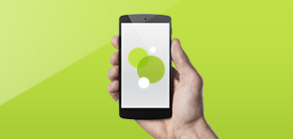
International Calling…How it Works
Call up to 15 unique international numbers per 30-day plan cycle, which resets each time a new plan is redeemed.
Calls must originate from the U.S., Puerto Rico or Mexico.
To check International availability Text: Country Code + City Code + Phone Number to 70257 (standard text message rates apply).
Includes Unlimited calls to Landline phones unless otherwise specified to the countries listed below.
Available International Destinations are subject to change without prior notice. Go to simplemobile.com/ild for the most current destinations.

Slide 20
International Destinations
American Samoa
Andorra
Argentina
Australia
Austria*
Bangladesh*
Belgium*
Bermuda*
Brazil*
Bulgaria
Canada*
Chile
China*
Colombia
Costa Rica
Croatia
Cyprus
Czech Republic
Denmark*
Dominican Republic
Estonia
France*
Germany*
Greece
Guadeloupe
Hong Kong*
Hungary
Iceland
India*
Indonesia
Ireland
Israel*
Italy
Japan
Lithuania
Luxembourg
Malaysia*
Malta
Mexico*
Mongolia*
Morocco
Netherlands
New Zealand
Norway
Pakistan*
Panama
Paraguay
Peru
Poland*
Portugal
Romania Singapore
Slovakia
Slovenia
South Africa
South Korea*
Spain*
Sweden
Switzerland
Taiwan
Thailand
United Kingdom
Uruguay
Uzbekistan
Venezuela*
*Includes Landline and Cellular Phones

Slide 21
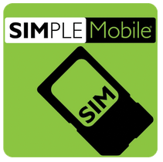
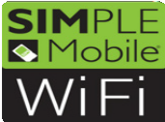
Mobile Apps
 | My Account | Google Play App Store | Displays Data Balance, Service End-Date, Dealer Locater and More!
 | International Dialer | Google Play App Store | Directly call International Numbers as stored contacts without the hassle of dialing access numbers.
 | DATA/APN Settings | Google Play | Updates your SIMPLE Mobile Data and Picture Messaging (MMS) settings for Android phones.
 | WiFi Locator | Google Play | Finds, manages and automatically connects to available WiFi Hotspots.

Slide 22
Budget constrained minimalist

Slide 23
Target Audience
Low phone usage
First cell phone (pre-teens), Seniors, People on a Fixed income
Does not understand latest technology
Very price conscience
For BYOP, those who have a compatible or unlocked 3G or 4G LTE Smartphone

Slide 24
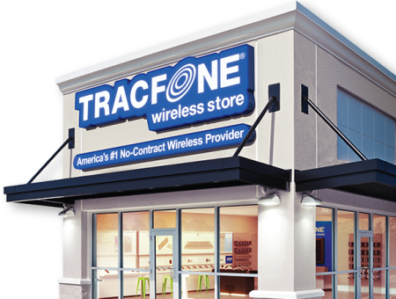
11 Airtime Plans
120 Minutes $29.99
200 Minutes $39.99
400 Minutes $99.99
450 Minutes $79.99
60 Minutes $19.99
Smartphone $15
Smartphone $25
Smartphone $35
Smartphone $125
Data 1GB $10
90 Day Plans starting as low as $19.99 (average $7 a month)
Smartphone Only Add-On Cards
3x Talk + 3x Text + 3x Data on all Smartphones
Double Minute benefits on all Basic phones
Unlimited Carryover of any Unused Minutes and Service Days as long as the service remains active
1000 Texts $5
6 Handset Options
ZTE 233
ZTE 798
ZTE 837
LG 58 VL
ZTE917
Samsung J3

Slide 25
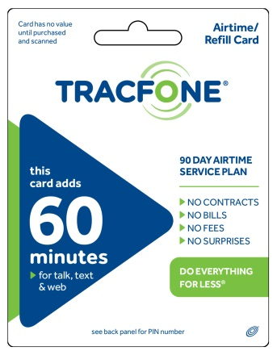
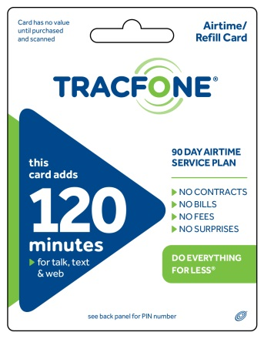
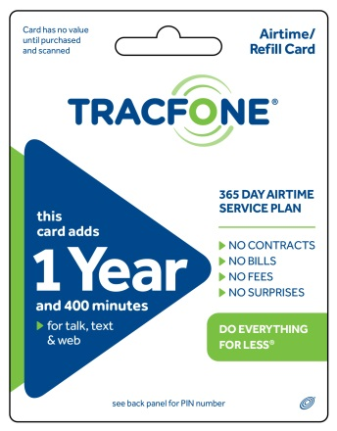
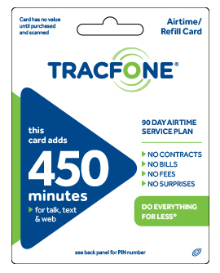
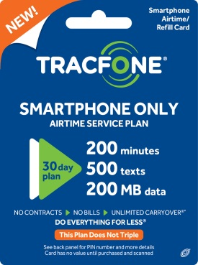
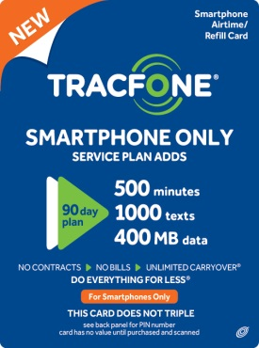
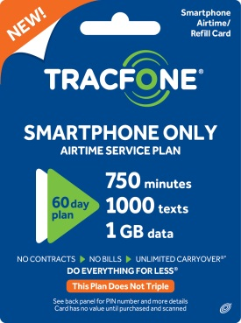
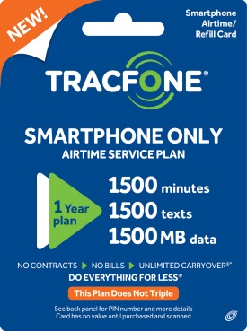
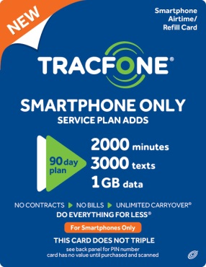
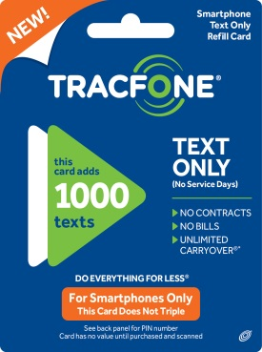
Phones Overview
Basic Phone Plans
Smartphone Plans

Slide 26
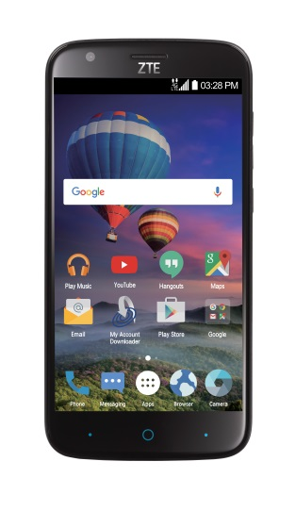
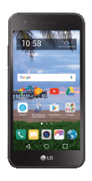
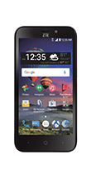
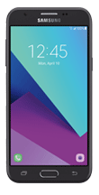
Phones Overview
ZTE
Z798BL
Majesty PRO LTE
ZTE
Z837VL
ZFIVE 2 LTE
ZTE
Z917VL
Zmax CHAMP LTE
LG
L58VL
REBEL 2 LTE
Samsung Galaxy J3
Luna Pro
ZTE
233

Slide 27
Airtime Plans
 |  |  | Smartphones & BYOP |  |  | Basic Phones
Service Plans |  | Average Cost per Month | 3x Talk Minutes | 3x Texts | 3x Data
$19.99 | 60 Minutes 90 Service Days | $7/month | 180 | 180 | 180 MB | 120
$29.99 | 120 Minutes 90 Service Days | $10/month | 360 | 360 | 360 MB | 240
$39.99 | 200 Minutes 90 Service Days | $14/month | 600 | 600 | 600 MB | 400
$79.99 | 450 Minutes 90 Service Days | $27/month | 1350 | 1350 | 1350 MB | 900
$99.99 | 400 Minutes 365 Service Days | $9/month | 1200 | 1200 | 1200 MB | 800
2x Minutes
Talk\Text\Web

Slide 28
New Smartphone Only Plans
MSRP | Talk | Text | Data | Service Days
$15.00 | 200 Min | 500 | 200 MB | 30
$25.00 | 500 Min | 1000 | 500 MB | 60
$35 | 750 Min | 1000 | 1 GB | 60
$125 | 1500 Min | 1500 | 1.4 GB | 1 Year
Does not Triple - What you see is what you get
Does not work on Basic Phones
Add-On Data Card - Smartphones Only
MSRP | Text | Text | Data | Service Days
$10.00 | N/A | N/A | 1 GB | N/A
Add-On Text Plan - Smartphones Only
MSRP | Talk | Text | Data | Service Days
$5.00 | N/A | 1000 | N/A | N/A

Slide 29
TracFone Smartphone Benefits
Smartphones use separate buckets for Talk, Text, and Data:
Smartphone and BYOP devices Triple the Talk, Text, and Data of each Face Value Airtime Card.
To keep the TracFone Service active, customers must add an Airtime Card prior to the Service End-Date of the phone, if not they may lose their phone number.
1 Minute of Talk = 1 Minute deducted from the Talk bucket.
1 Text Message = 1 Text deducted (incoming or outgoing) from the Text bucket.
Data is charged based on actual usage and is deducted from the Data bucket

Slide 30
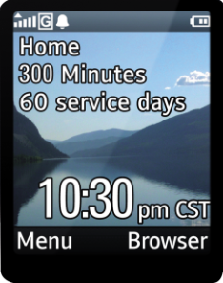
TracFone Basic Phone Benefits
TracFone Double Minute Benefit doubles the airtime the customer buys and adds to the TracFone for the life of the phone.
1 Minute of Local, Nationwide or International Long Distance calls = 1 Minute of Airtime deducted
3 Text Messages = 1 Minute of Airtime deducted (outgoing or incoming)
Data = 1.0 Minutes to send or receive a Multi-Media Message (MMS) Additional Data Charge of 0.5 Minutes will be deducted per Minute of use

Slide 31
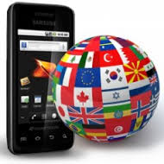
International Calling…How it Works
TracFone customers are automatically activated to use the International Long Distance calling service to over 100 destinations at no extra cost.
Dial 1-800-706-3839 TracFone’s International Long Distance Access Number. (From Alaska, Hawaii and the U.S. Virgin Island dial 305-938-5673). Select a language (1 - English, 2 - Spanish).
Dial 011 + Country Code + City Code + Number (For Canada just dial: 1 + City Code + Number).

Slide 32
International Destinations
Albania - Tirana | France (33) | Malta (356)
Andorra (376) | French Antilles (596) | Mexico (52)
Argentina (54) | French Guiana CELLULAR (594) | Mexico CELLULAR NEW (52)
Australia (61) | French Guiana (594) | Monaco (377)
Austria (43) | Georgia (995) | Netherlands (31)
Bahamas CELLULAR(1) | Germany (49) | New Zealand (64)
Bahamas (1) | Gibraltar (350) | Norway (47)
Bangladesh CELLULAR(880) | Greece (30) | Panama (507)
Bangladesh - Chittagong (880) | Guadeloupe (590) | Paraguay (595)
Bangladesh - Dhaka (880) | Guatemala - Telgua (502) | Peru (51)
Bangladesh - Sylhet (880) | Hong Kong CELLULAR (852) | Poland (48)
Belgium - (32) | Hong Kong (852) | Portugal (351)
Bermuda CELLULAR (1) | Hungary (36) | Romania (40)
Bermuda (1) | Hungary-Budapest (36) | Russia CELLULAR (7)
Bolivia - La Paz (591) | Iceland (354) | Russia (7)
Bolivia - Santa Cruz(591) | India CELLULAR (91) | San Marino (378)
Brazil (55) | India (91) | Saudi Arabia - Riyadh (966)
Brunei (673) | Indonesia - CELLULAR (61) | Singapore (65)
Bulgaria (359) | Indonesia - Jakarta (62) | Slovakia (421)
Canada CELLULAR (1) | Indonesia - Surabaya (62) | Slovenia (356)
Canada (1) | Iraq - Baghdad (964) | South Korea CELLULAR (82)
Chile (56) | Ireland (353) | South Korea (82)
China CELLULAR (86) | Israel (972) | Spain (34)
China (86) | Italy (39) | Sweden (46)
Colombia CELLULAR (57) | Japan (81) | Switzerland (41)
Colombia (57) | Jordan (962) | Taiwan CELLULAR (886)
Costa Rica (506) | Kazakhstan (7) | Taiwan (886)
Croatia (385) | Kenya - Nairobi (254) | Thailand (66)
Cyprus CELLULAR (357) | Lithuania (370) | Turkey (90)
Cyprus (357) | Luxembourg CELLULAR (352) | United Kingdom (44)
Czech Republic (420) | Luxembourg (352) | Uzbekistan (7)
Denmark (45) | Macao CELLULAR (853) | Venezuela (58)
Dominican Republic (1) | Macao (853) | Vietnam - Ho Chi Minh
Estonia (372) | Malaysia CELLULAR (60) | Zambia (260)
Finland (358) | Malaysia
*Destinations are subject to change at any time

Slide 33
Additional International Services…
TracFone International Neighbors
Customers can get up to three FREE local phone numbers in Mexico that their friends and family can use to call their TracFone in the U.S. without long distance charges.
Friends and Family pay for a local call and the customer pays for an incoming call.
Customers simply need to go to www.tracfone.com or call the customer service at 1-800-867-7183 to set up this service.

Slide 34
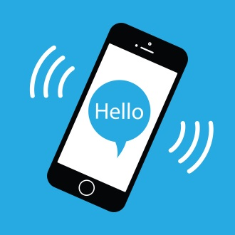
TracFone Frequent Numbers
TracFone’s Frequent Numbers offers customers up to 10 U.S. 1-800 numbers, which can be assigned to the most frequently dialed international numbers.
Customers do not need to dial TracFone’s International Long Distance access number; making it a one number quick dial.
TracFone customers simply need to obtain this service free of charge by visiting TracFone.com or by calling customer service center at 1-800-867-7183.

Slide 35
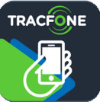
Mobile Apps
 | My Account | Google Play App Store | Displays Data Balance, Service End-Date, Add an Airtime Card and More!
 | International Dialer | Google Play | Directly call International Numbers as stored contacts without the hassle of dialing access numbers.

Slide 36
The Smart and Savvy customer looking for ways to save

Slide 37
Target Audience
People who want a Family Plan, but don’t want to share the Data
Post-Paid Customers
Need the flexibility to switch plans when needed
Want to keep their own phone and number, but don’t want a contract
Want their choice of Networks
For BYOP, those who have a compatible or unlocked
3G or 4G LTE Smartphone

Slide 38
Unlimited Talk, Text and Data starting as low as $35 per month
Single or Family & Friends Plans with Unlimited Talk, Text and Data
Pay-As-You-Go Airtime Cards will only work with Basic Phones not with Smartphones
Great 4-Line Family plans with 5 GB each per line for $170
12 Airtime Plans
300 Minutes $25
1000 Minutes $30
1 GB Data $20
2.5 GB $30
500 MB Data $10
5 GB $50
Family Plan $75
Family Plan $90
Unlimited $35
Unlimited $50
Unlimited $65
Unlimited $40

Slide 39
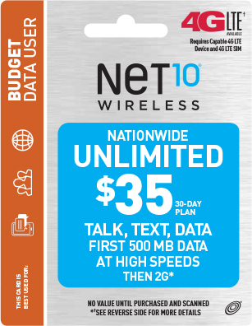
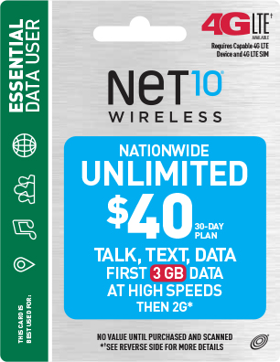
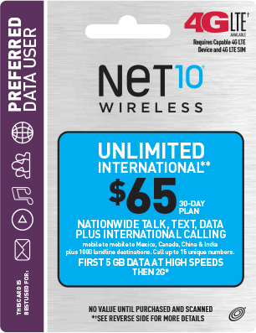
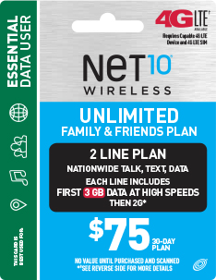
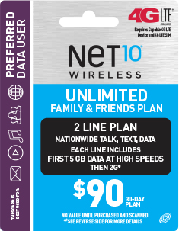
Plans Overview
Unlimited
Plans
…Family Plans

Slide 40
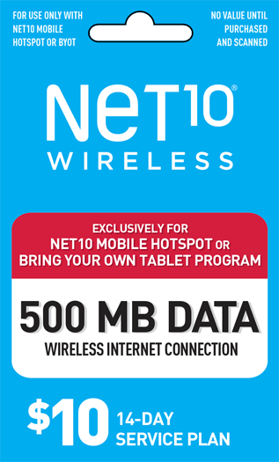
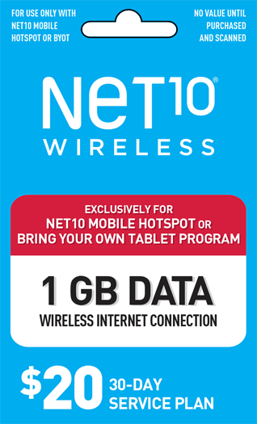
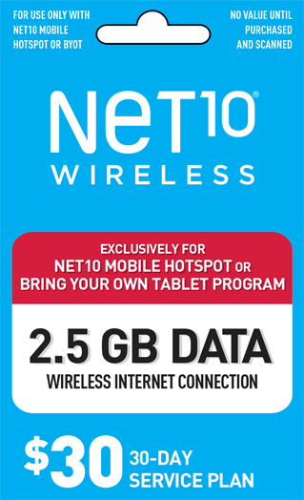
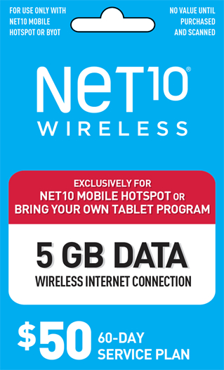
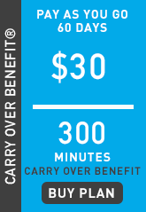
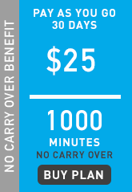
Data Plans
Pay-As-You-Go Plans

Slide 41
30-Day Unlimited Individual Plans
Price | Nationwide Talk & Text | Data
$35 | Unlimited | 500 MB High Speeds then 2G
$40 | Unlimited | 3 GB High Speeds then 2G
$50 | Unlimited | 5 GB High Speeds then 2G
$65 | Unlimited Plus International Calling | 5 GB High Speeds then 2G
30-Day Unlimited Family Plans
Price | Nationwide Talk & Text | Data
$75 | Unlimited - 2 Lines | 3 GB High Speeds then 2G Per Line
$90 | Unlimited - 2 Lines | 5 GB High Speeds then 2G Per Line

Slide 42
Pay-As-You-Go Cards
Pay-As-You-Go Airtime Cards will only work with Basic Phones not with Smartphones.
1 Minute of Local or Nationwide Long Distance calls equals one minute of airtime deducted.
Minutes are deducted for all incoming and outgoing calls, including calls to toll free numbers, 411, 611, *611, Customer Care, and Voice Mail.
911 calls are free. Minutes will not be deducted.

Slide 43
Pay-As-You-Go Cards
Plans | Talk, Text or Data | Service Days | Carryover | International Calling
$25 | 1000 min | 30 | No | Yes
$30 | 300 min | 60 | Yes | Yes
International Calling to over 100 Destinations is included.
Customers can go to NET10.com/ild and click on the Pay-As-You-Go International for more information.

Slide 44
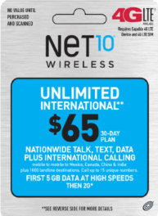
$65 Unlimited International Plan
Unlimited Nationwide Talk, Text and 5 GB High Speed Data plus Unlimited International Calling to over 1,000 destinations
Call up to 15 unique destination numbers per month
Unlimited Mobile to Mobile calling to Mexico, China, India & Canada and more (*400 Bonus Minutes to call Claro Cellular phones in Guatemala)
International calling must originate from the U.S.
Includes 30 Service Days, destinations may change without notice at any time

Slide 45
International Calling…How it Works
Pay-As-You-Go Airtime customers can make calls to over 100 Destinations.
Calls to cellular phones are not included unless the word “Cellular” is specifically listed next to the country name (numbers in parentheses indicate the Country Code).
1 Minute of International Long Distance equals 1.5 Minutes deducted.
Customers can go to NET10.com/ild and click on the Pay-As-You-Go International for more information.

Slide 46
International Destinations
Albania - Tirana (355) Andorra (376) Argentina (54) Australia (61) Austria (43) Bahamas - Cellular (1) Bahamas (1) Bangladesh - Cellular (880) Bangladesh - Chittagong (880) Bangladesh - Dhaka (880) Bangladesh - Sylhet (880) Belgium (32) Bermuda - Cellular (1) Bermuda (1) Bolivia - La Paz (591) Bolivia - Santa Cruz (591) Brazil (55) Brunei - Cellular (673) Brunei (673) Bulgaria (359) Canada - Cellular (1) Canada (1) Chile (56) China - Cellular (86) China (86) Colombia - Cellular (57) Colombia (57) Costa Rica (506) Croatia (385) Cyprus - Cellular (357) Cyprus (357) Czech Republic (420) Denmark (45) Dominican Republic (1) Estonia (372) Finland (358)
Mexico (52) Monaco (377) Netherlands (3) New Zealand (64) Norway (47) Panama (507) Paraguay (595) Peru (51) Poland (48) Portugal (351) Romania (40) Russia- Cellular (7) Russia (7) San Marino – Cellular (378) San Marino (378) Saudi Arabia – Riyadh (966) Singapore- Cellular (65) Singapore (65) Slovakia (421) Slovenia (386) South Korea –Cellular (82) South Korea (82) Spain (34) Sweden (46) Switzerland (41) Taiwan – Cellular (886) Taiwan (886) Thailand (66) Turkey (90) United Kingdom (44) Uzbekistan (7) Venezuela (58) Vietnam - Ho Chi Minh (84) Zambia (260)
France (33) French Antilles (596) French Guiana - Cellular (594) French Guiana (594) Georgia (995) Germany (49) Gibraltar (350) Greece (30) Guadeloupe (590) Guatemala - Telgua (502) Hong Kong - Cellular (852) Hong Kong (852) Hungary (36) Iceland (354) India - Cellular (91) India (91) Indonesia - Cellular (62) Indonesia - Jakarta (62) Indonesia - Surabaya (62) Iraq - Baghdad (964) Ireland (353) Israel (972) Italy (39) Japan (81) Jordan (962) Kazakhstan(7) Kenya - Nairobi (254) Lithuania (370) Luxembourg - Cellular (352) Luxembourg (352) Macao - Cellular (853) Macao (853) Malaysia - Cellular (60) Malaysia (60) Malta (356) Mexico - Cellular (521)
*Available International Destinations are subject to change without prior notice.

Slide 47
Mobile Apps
 | My Account | Google Play App Store | Displays Data Balance, Service End-Date, Add Airtime and More!
 | International Dialer | Google Play App Store | Directly call International Numbers as stored contacts without the hassle of dialing access numbers.
 | DATA/APN Settings | Google Play | Instructions to program Data and Picture Messaging settings for an Android device.
 | WiFi Locator | Google Play | Finds, manages and automatically connects to available WiFi Hotspots.

Slide 48
Budget Conscience Customers, Especially with Families

Slide 49
Mobile Apps
 | My Account | Google Play App Store | Displays Data Balance, Service End-Date, Add Airtime and More!
 | International Dialer | Google Play App Store | Directly call International Numbers as stored contacts without the hassle of dialing access numbers.
 | DATA/APN Settings | Google Play | Instructions to program Data and Picture Messaging settings for an Android device.
 | WiFi Locator | Google Play | Finds, manages and automatically connects to available WiFi Hotspots.

Slide 50
Mobile Apps
 | My Account | Google Play App Store | Displays Data Balance, Service End-Date, Add Airtime and More!
 | International Dialer | Google Play App Store | Directly call International Numbers as stored contacts without the hassle of dialing access numbers.
 | DATA/APN Settings | Google Play | Instructions to program Data and Picture Messaging settings for an Android device.
 | WiFi Locator | Google Play | Finds, manages and automatically connects to available WiFi Hotspots.

Slide 51
6 Airtime Plans
Service on America’s Largest and Most Reliable 4G LTE Network
Shared Data Family Plans
Unlimited Talk and Text on all Plans
Data up to 4G LTE Speeds
Add-On Carryover Data Card
No Contract, No Credit Check, No Activation or Cancellation Fees
Keep your number or get a new one
Unlimited $25
Unlimited $35
2- Line $60
3-Line $85
4-Line $100
Bolt-On Card $10
3 Handset Options
ZTE 233
ZTE 799
LG 58VL

Slide 52
Plans Overview
Unlimited Plans
Add-On Card

Slide 53
Phones Overview
ZTE
799VL
Majesty PRO LTE
LG
L58VL
REBEL 2 LTE
ZTE
233

Slide 54
30-Day Unlimited Individual Plans
Plans | $25 | $35
Nationwide Talk & Text | Unlimited | Unlimited
Capped Data | N/A | 5 GB
Auto Refill | Yes | Yes
$10 Add-On Data
Add-On Data | $10
Nationwide Talk and Text | No
Shared Capped Data | 3 GB
Service Days | None
Auto Refill | No
Carryover Data | Yes

Slide 55
How Multi-Line Shared Data Plans Work…
Multiple devices are not required to be used with Multi-Line Shared Data Plans. These plans can be used with just 1 device.
Customers have a choice of Multi-Line Shared Data Plans that can support up to (4) devices.
Multiple lines of one Shared Data Plan is called a Group. The Service Plan determines how many devices can be added to a group.

Slide 56
Multi-Line Shared Data Plans
The first device of the Group to be activated determines the service end date of all the devices within the group.
Any line activated later in the 30-Day cycle will only receive the number of days remaining in the cycle.
Plans | $60 | $85 | $100
Devices | 2 | 3 | 4
Nationwide Talk & Text | Unlimited | Unlimited | Unlimited
Shared Capped Data | 8 GB | 12 GB | 15 GB
Auto Refill | Yes | Yes | Yes

Slide 57
How Multi-Line Shared Data Plans Work
Once the customers Data is used up, the Data will be turned off, however the customer will still have Talk and Text for the remaining service days.
If the customer needs more Data, they will have a choice of buying $10 Add-On Carryover Data Card or buying a new plan.
If a customer adds a new Multi-Line Shared Data Plan prior to their Service End Date, they will lose any remaining Data and Service Days left on their plan.

Slide 58
The BYOP Process

Slide 59
Help the customer determine which brand is best based on their needs and phone compatibility
Accepts GSM phones | Accepts both GSM and CDMA phones | Accepts both GSM and CDMA phones | Accepts CDMA phones

Slide 60
Video: Bring Your Own Phone (BYOP)

Slide 61
Customers can bring their own compatible T-Mobile or an Unlocked GSM phone.
The phone must operate on either 850 or 1900 MHZ frequencies.
They may buy a Simple Mobile SIM card and a Service plan of preferred amount.
Then, insert the SIM card that fits the phone.
They can follow the easy activation instructions available in the SIM package or at SimpleMobile.com.

Slide 62
Customers can bring their own compatible 3G or 4G LTE Smartphone to TracFone Check phone eligibility first by texting “TFBYOP” to 82888 (standard text message rate applies) or visit TracFoneBYOP.com.
Customer purchases the TracFone BYOP Activation Kit.
Chooses a TracFone Airtime Service Plan to complete activation (works with all Airtime Plans).
To Activate, they can go to www.TracFoneBYOP.com, or call the Customer Care Center at 1-800-867-7183.
APN data settings should automatically download within 5 minutes. If it doesn't, Text APN to 611611, and within minutes the data settings should download. The customer will receive a Text Message to turn the phone off and on.

Slide 63
NET10 Requires a compatible or unlocked 3G or 4G LTE Smartphone.
Check phone eligibility first by texting “NTBYOP” to 82888 (standard text message rate applies) or at NET10BYOP.com or by calling 1-855-333-2355.
Customer purchases a Bring Your Own Phone Activation Kit.
They may follow the instructions on the Red Activation card included in the Kit.
Add the $40 Service Plan that is included in the Activation Kit to complete activation.

Slide 64
It will only work with a compatible CDMA handset.
Customer must check compatibility first online at TWBYOP.com/insert or by calling 1-866-663-3633.
Once on site, you will be asked to dial * # 0 6 # to get your MEID/MEID HEX/MEID DEC from the device that you want to use and enter that with your zip code.

Slide 65
Any Questions?
Thank You!

