Slide 1
D242 Nuclear Outside Machinists
Course Number: E004805
Effective Date: ____________
COURSE TITLE: Repair & Maintenance of Secondary Valves
COURSE HOURS: 24 Hours
OBJECTIVES: Upon completion of this training, the student will be able to:
Describe common types of secondary valves
Apply valve repair procedures & TWD requirements to secondary valve repacking and repair.
Demonstrate proper work practices including cleanliness controls & material handling.
Demonstrate their ability to perform selected valve repair activities.

Slide 2
Training Package Concurrence Page
(View in Notes Page)
Notes:
TRAINING PACKAGE CONCURRENCE PAGE
ITEM NUMBER: EXXXXX
Lesson Plan Title
Prepared by: Enter Name
All reviewers/approvers reviewing the lesson plan materials shall validate the following as applicable: course description states the purpose of the training and includes the source of the training requirement, all knowledge requirements are addresses, the technical content is accurate, and the desired work practices are discussed.
NTT SUPERVISOR: I have reviewed the specified Lesson Materials with the preparer.
_____________________________________ ___________________________________
Print – Name/Badge/Dept Signature Date
SUBJECT MATTER EXPERT: I have reviewed the specified Lesson Materials for technical content, accuracy, and current best work practices.
_____________________________________ _____________________________________
Print – Name/Badge/Dept Signature Date
PROCESS OWNER: I have reviewed the specified Lesson Materials for scope of work, desired content, technical accuracy, and current best work practices.
_____________________________________ _____________________________________
Print – Name/Badge/Dept Signature Date
OTHER REVIEWER, if applicable (i.e., Environmental, Safety, etc.): _______________________
_____________________________________ _____________________________________
Print – Name/Badge/Dept Signature Date
TRAINING DEPARTMENT: I have reviewed the specified Lesson Materials for conformance to requirements and approve the materials for use.
_____________________________________ _____________________________________
Print – Training Dept Chief Signature Date
[Documents] may be routed for review and approval by electronic mail, through the use of a Management Review Form or other appropriate means. Electronic mail approvals are equivalent to hard-copy signatures (per SP 5-1 Appendix A paragraph 1).
Preparation and review signatures may be made in any order, with the exception that the last review and signature will be made by the Training Department Chief.

Slide 3
Review
and
Revision History
(View in Notes Page)

Slide 4
Introduction:
Instructor(s)
Trainees
Time Charge: 000026005304921
Facilities
Breaks
Rules
Emergency Evacuation Location/Head Count
Cell Phone use

Slide 5
Evacuation Muster Location
Evacuation Muster Location
H
128
NORTH
Nuclear Pipe Shop
Engine Stores
19
Classroom Area Muster Here
YOU ARE HERE
Mock-Up Area Muster Here
D-29
154
130
184
Classrooms
18
8-S
169
Mock-Up Area
Notes:
Safety is our primary focus (TDI-642-001-2)
Make sure trainees are familiar with the nearest exit and designated muster area.
In the event of fire or other emergency requiring evacuation, all trainees and staff will evacuate the building, assemble and remain at the designated muster area until released by the Fire Department Incident Commander (FDIC).
At the muster area, each instructor will initiate accountability checks and advise the supervision responsible for the area that all their students are present; missing personnel must be reported to the FDIC.
Evacuation Muster Locations From Bldg. 130:
Classrooms evacuate to muster point 19, located near the helipad directly across from Engine Stores (Nuclear Pipe Shop).
Prac Fac area (High Bay) evacuate to muster point 18 Bldg. 154, across from Bldg. 169 Rad Con Training.

Slide 6
Learning Objectives
Learning Objectives
At the end of this course students will be able to:
LO1
Describe the procedure for installing lockwire on mechanical locking devices: MDD-00679.
Discuss locking cable policy and procedure and installation of lock tabs: MDD-00679.
LO2
Identify self-locking bolts and elastic stop installation: MDD-01741, MDD-03503.
LO3
LO4
Recognize valves types, identification/marking, and proper installation methods: NSI 0506, NSI 0802, SSP 02.38.
Discuss storage requirements, inspection attributes, and tools used to check flexible hoses: SSP 02.14.
LO5
Notes:
Learning Objectives
Review with students.
Let them know WIIFM—what they will get from the training, how it benefits them.
Evaluation will be based on completing a written test with a minimum passing grade of 75%, 80% for Instructors and Supervision.

Slide 7
Locking Devices
Why are locking devices used?
Locking devices are installed on threaded fasteners to prevent them from becoming loose due to shock and/or vibration.
When do we install lockwire?
Whenever possible, we don’t install lockwire until testing shows there is no leakage.
LO1
Notes:
Purpose of Locking Devices
Locking devices are used to ensure fasteners do not loosen due to shock and or vibration.
When to Lockwire/Cable
Whenever possible, lockwire/locking cable should not be deformed until final fastener adjustments are made or otherwise specified. The work document may specify when fasteners are to be lock wired.
Fasteners on gasket joints should not be lock wired until system test is complete, with no leakage.
Install lockwire or locking cable such that wire tightens as fastener loosens.
REFERENCES
MDD-03503 NYLON INSERT NUTS AND ALLOWABLE THREAD EXPOSURE
MDD-01741 FABRICATION AND INSTALLATION OF NYLON INSERT BOLTS
MDD-00679 INSTALLATION OF MECHANICAL LOCKING DEVICES

Slide 8
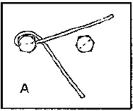
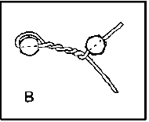
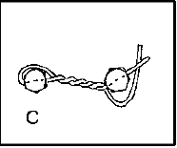
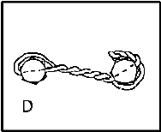
Locking Wire Procedure
Fastening Method for Holes Drilled Through Bolt Head, Nut, or Stud
Lockwire shall be installed so the wire tightens as the fastener loosens.
All fasteners shall be lock wired in pairs, except when there is an odd number of fasteners.
IAW MDD-00679 Inconel Lockwire shall be used unless otherwise directed by a work document or TWD
LO1
Notes:
Safety Equipment
Always wear safety glasses when installing lockwire/safety cable.
Lockwire Procedure: (Groups of Two)
Figure 1: MDD-00679 (Center Drilled)
1. All fasteners shall be secured in pairs, except when there is an odd number of fasteners (i.e., a group of three may be wired together) or when work document specifies another method (e.g., individual fastener to structure).
2. Break all sharp edges on lockwire holes or corners of nuts/bolts (minimum break of 0.003”).
3. Insert wire/cable through hole of bolt or nut (double wire).
4. Pull out slack around head & determine amount of lockwire/cable needed.
5. Install lockwire/cable such that wire tightens as the fastener loosens.
6. Use lockwire pliers (jet twisters) to pull slack and twist wire.
NOTE: Gripping surfaces of the tool should be taped to protect the lockwire from damage.

Slide 9
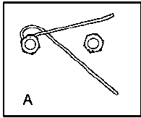
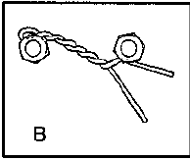
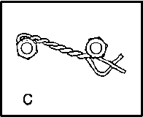
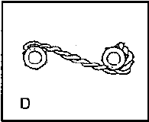
Locking Wire Procedure Continued
Figure 2: Method for Corner Drilled Nut Installation
R H
For 0.062” dia.
1-1/2 minimum complete turns per inch
R H
For 0.032” dia.
3 minimum complete turns per inch
LH
Cut off end (pigtail) with 1-1/2 minimum turns and bend down
LH
LO1
Notes:
Lock Wiring Procedure (Continued)
Start twist by pulling slack at wire ends, and right-hand twist:
Insert wire through adjacent fastener. Twist must be taut between fasteners.
Pull wire ends to remove slack, and left-hand twist.
Cut off end (pigtail) with a 1-1/2 minimum turns and bend down.
NOTE: Excessive length pigtails considered a personal hazard or interferes with equipment operation may be written on a TIR during inspection.
Lock wiring of Left-Hand Threaded Fasteners
For left-hand threaded fasteners, the twist and terminations are in the opposite direction.

Slide 10
Lockwire Procedure Continued
Lockwire shall not be damaged (nicked, scored, or cracked). Installation method shall minimize damage. Burnishing is acceptable.
2. Control twists and turns as shown:
1”
Cross wires to start
One
Twist
First
Turn
Second
Turn
Third
Turn
3. Drill and examine holes before installing lockwire.
Break all sharp edges on lockwire holes and corners on bolt heads to a minimum
of 0.003”.
Right-hand threaded fastener shown—left-hand threaded fasteners twist and
terminate are in the opposite direction.
LO1
Notes:
Simplified view for determining a twist and minimum turns per inch.
A scale is used to measure for minimum turns per inch, per each inch of lockwire.
First complete turn is made of three (3 twist: over, under, over).
Every two (2) twist beyond the first turn is considered a complete turn.
Three (3) complete turns per inch is the minimum required.

Slide 11
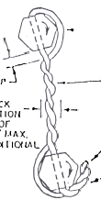
Inspection of Lockwire
INSPECTION OF LOCKWIRE
1/8” max slack either direction for the first 3” of twist + 3/64” for each additional inch.
L.H. pigtail end is 1-1/2 turns min.
R.H.
LO1
Notes:
Inspection of Lockwire
Figure 1 MDD-00679
Lockwire shall be visually inspected for damage (nicks, scores, or cracks). Scratches are acceptable, provided there is no raised metal. (Burnishing is acceptable.) Damage beyond the 1-1/2 turns of the pigtail is acceptable.
Wire is not required to touch all corners of fasteners, but must be tight enough so wire will not come up over the head or nut.
Wires shall be in contact with each other throughout the twisted length.
Wire should be inspected for correct orientation and sufficient turns.
Wire should be inspected for slack requirements.

Slide 12
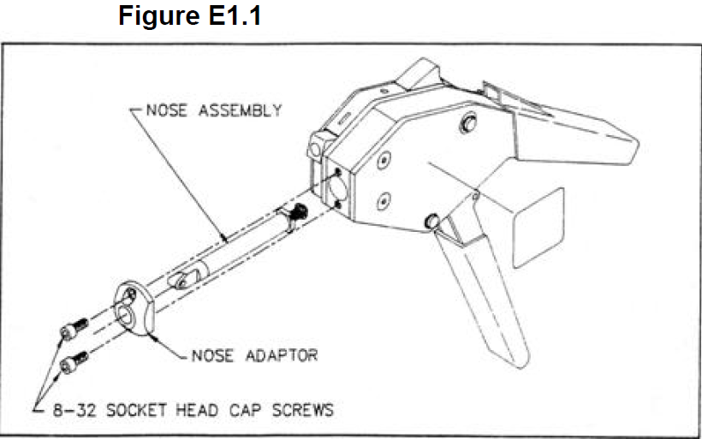
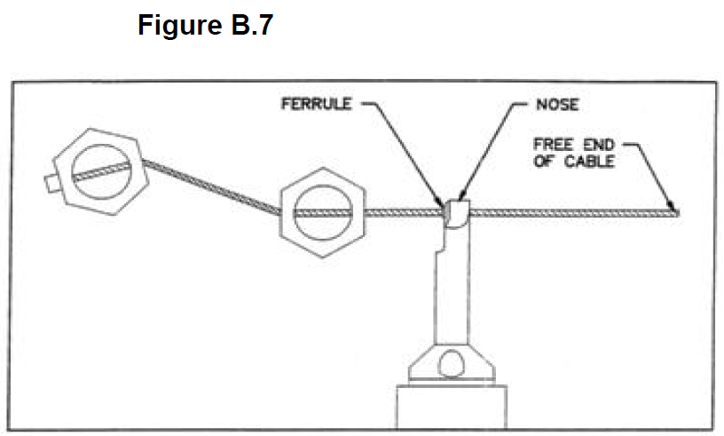
Locking Cable Tool
Instruction for the Calibration and Use of the Locking Cable Tool per MDD-00679
Locking cable size used shall be 0.032” or 0.062” diameter corrosion- and heat-resistant steel
LO2

Slide 13
Lock Tabs
MIL-STD-763G Lock Tabs
Monocle Type
Spectacle Type
Short tab bends against the flat of the fastener
Long tab bends against the outside surface of the item
Lock tabs are installed during assembly or installation
LO2
Notes:
Lock Tabs
Locking devices shall be installed in accordance with drawings or installation instructions.
Types:
Lock tab (monocle and spectacle type)
Lock plate
Installation (Figures 6 & 8)
When required to be installed by the drawing, lock tabs should be installed with the fasteners as part of the mechanical joint assembly.
NOTE: The lock tabs should be installed, but the tabs need not be bent at this time.

Slide 14
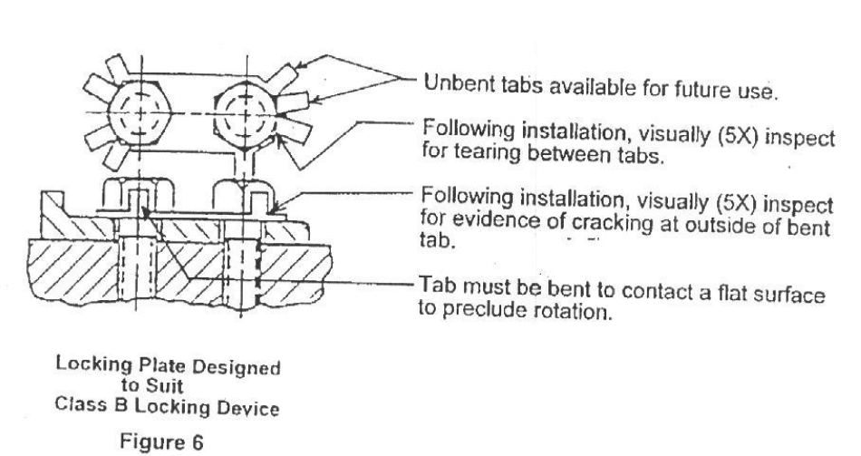
Bending Lock Tabs
Figure 6 Method for Bending Lock Tabs
LO2
Notes:
Lock Tab Installation Procedure:
Figure 6 of MDD-00679
Lock tabs are installed in a manner as to prevent loosening.
Bending of the tabs is accomplished by the use of brass wedges, hammer and/or screwdriver—use care to not damage the locking device.
Bend short tab against flat of fastener.
Bend long tab against flat side of outside surface to prevent fasteners from loosening.
Lock tabs that have been straightened shall not be reused, unless specifically allowed by work document.
The ends of bent tabs shall not create a personnel hazard or impair equipment operation.

Slide 15
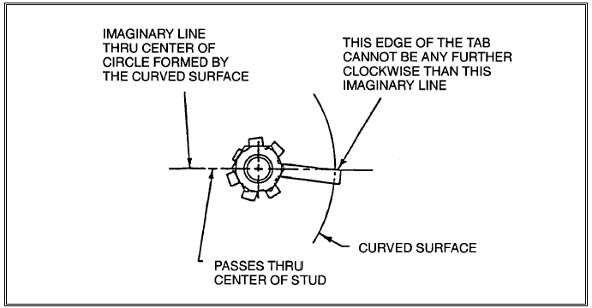
Installation To A Curved Surface
Figure 8: Installation to a Curved Surface
LO2
Notes:
LOCK TAB INSTALLATION TO CURVED SURFACE
Figure 8: MDD-00679 For curved or flanged surfaces.
The ends of bent tabs shall not create a personnel hazard or impair equipment operation.
Refer to the lock tab detail drawing for the minimum lengths of tabs.

Slide 16
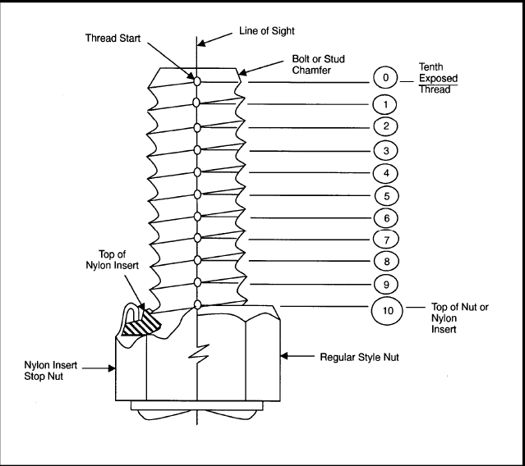
Thread Protrusion
Thread Protrusion
Check fastener thread protrusion for a range of 1 thread minimum, up to 5 threads.
Virginia Class allows flush with full thread engagement.
A maximum protrusion of 10 threads is allowable providing the protrusion does not present a personnel hazard.
LO3
Notes:
NSI 0802 enclosure 4 item 15, NSI 1002 enclosure 5 item 11:
After installation of nuts or bolts, check the number of exposed threads. (See Figures 1 and 2.)
Although a one-thread protrusion after installation is preferred, fastener threads may be flush with the top of the nut or plastic locking element.

Slide 17
Elastic Stop Nut Installation
Elastic Stop Nut Installation
Prior to assembly, make sure threads are clean and free from nicks and gouges.
For Virginia-Class Boats, the applied torque is already calculated.
Locking insert is free from cracks
LO3
Notes:
Locking methods using Elastic Stop Nuts (ESN) MDD-03503
When a torque is required for installation of a self-locking nut, the following process shall be followed:
a. Unless otherwise specified by drawing, add the running torque of the nut to the specified torque to achieve the correct installation torque value.
b. When recording the torque required to install a self-locking nut, subtract the running torque from the installation torque where running torque was required to be determined, and record the difference; otherwise, record the applied torque.
Reuse
If resistance is noticeably less, test breakaway torque to Table I of MDD-03503 or replace the nut.

Slide 18
Knowledge Check
0.030” and 0.060” are the two sizes of lockwire that we use.
True
False
What size lockwire do we use?
0.032” and 0.062”
LO3
Notes:
Animated slide: question and answer appear on click.

Slide 19
Knowledge Check
What kind of material do we use for lock wiring Nuclear applications unless otherwise directed by Nuclear Engineering?
Inconel
Nickel-Copper
Cres
Aluminum
LO3

Slide 20
Lessons Learned
Lessons Learned
Electric Boat has not had any recent issues with improper orientation of nuclear valves or nuclear piping not installed per plan.
To ensure that we don’t have these problems again in the future, remember the importance of ensuring nuclear valves and piping are correctly installed.
LO4
Notes:
Discuss the importance of performing your work right the first time, every time.

Slide 21
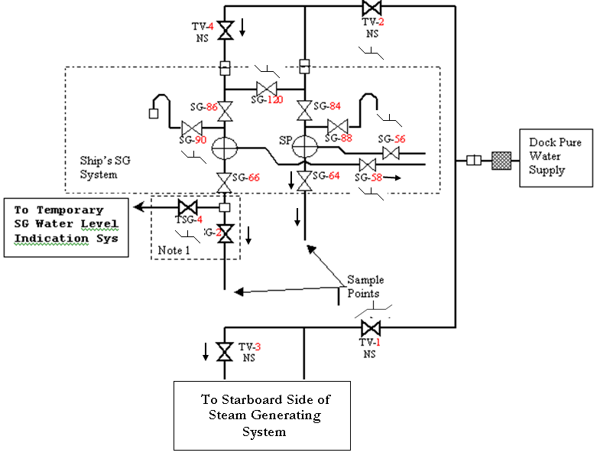
Systems Diagrams
System Diagrams
During NQCI I/C inspection of the systems to NSI 0802, the system diagram shall be used as the primary source for determining valve orientation.
LO4
Notes:
Animated slide: text block shows on click.
NQCI System Inspections
Systems are inspected by NQCI in accordance with a test form/test procedure, working drawings and applicable Type D and N ERs.
Trades DO NOT work to system diagrams.
Construction Drawings
Construction drawings are authorized for the fabrication and installation of ships systems.
Trades are to install piping to the drawing requirements.
Corrections to construction drawing can only be made by Engineering.
Engineering Reports may be used to document drawing deficiencies and omissions.
Notify your Foreman of any drawing deficiencies or omissions.

Slide 22
Valve Body Markings
Valve Body Markings
Globe valves require a bridge wall mark to indicate the location of the internal wall relative to the seat, unless marked with a flow arrow or the inlet and/or outlet are clearly identified.
Globe Valve
Bridge Wall
LO4
Notes:
Valve Body Markings (NSI 506)
Globe Valves
System Flow
Bridge Wall symbols do not represent system flow.
NEVER attempt to determine valve orientation, based on system flow.
System Flow is indicated by flow arrows.

Slide 23
Valve Orientation
Valve Orientation
Stem Packing
Disc
Fluid in piping on this side of valve is on stem packing when valve is shut (B)
Fluid in piping on this side of valve is isolated from stem packing when valve is shut (A)
LO4
A
B
Notes:
Bridge Wall Symbol
The Bridge Wall symbol for globe valves on drawings indicates the valves orientation with regard to stem/disc orientation.
All valves must be installed with their bridge wall markings on the valve body, oriented in the same direction, as the bridge wall markings shown on the drawing.
Typical globe valves are oriented such that the flow is from the A to the B port.
Regardless of system flow, globe valves are always oriented based on the bend data notes or the orientation found in the arrangement drawing. Some globe valves are installed with the flow direction opposite of the system flow by design. Do not assume that valves are always installed with the flow direction matching the system flow direction.
NOTE: Valves are occasionally supplied from the vendor with the “A” and “B” port pre-stamped on the valve opposite to the designation found in this SSP (used as a vendor aid for manufacturing). For these cases, the “A” and “B” pre-stamped designations should be ignored. The bridge wall, flow arrow, and/or appropriate figures should be followed for fabrication guidance. Always verify the valve orientation markings are correct in accordance with this attachment prior to installing any valve.

Slide 24
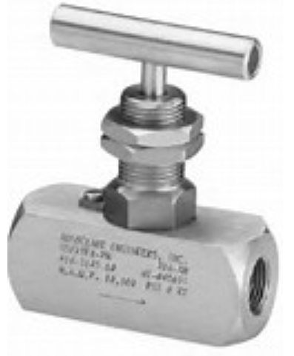
Flow Arrow
Flow Arrow
Some valves may have a flow arrow ( ) etched or embossed rather than a bridge wall symbol.
A
B
These symbols are alike—when installed, the fluid on the left of the arrow will exert pressure under the valve seat.
LO4
Notes:
Flow Arrows
The flow arrow is also a symbol that indicates valve orientation. The flow arrow represents the normal inlet and outlet of the valve for installation.

Slide 25
Types of Valves
Types of Valves
Gate Valve: No specific flow path, unless hydraulic operated and flow is identified on drawing. “A” Port (Inlet)/“B” Port (Outlet)
Globe Valve: Flow orientation is identified by a bridge mark on drawing @ valve body.
Includes: Globe Stop Check (SC)
Globe Lift Check (LC)
Globe Throttle (GT)
Globe Needle (GN)
Check Valve: Backflow prevention—flow orientation is identified by a flow arrow on drawing @ valve body.
Ball Valve: No specific flow orientation—operator orientation may be specified.
Relief Valve: Prevents over-pressurization—capacity and set pressure IAW system diagram.
Vent/Drain Valve: No specific flow orientation—vent port may be specified on system diagram.
LO4
Specific valve body and bonnet markings are identified in NSI 0802
Notes:
Types of Valves
Valve markings indicative of special requirements shall be on the bonnet or gland unless indicated by permanently attached identification.

Slide 26
Special Markings
These components all fit in the same body
GLOBE
THROTTLE
STOP CHECK
LIFT CHECK
LO4
A
B
Notes:
Special Markings
Pipefitters should ensure that the type of valve is correct according to the drawing. The letters “GS” indicate the valve is a GLOBE STOP. “LC” indicates the valve is a LIFT CHECK. SC = Stop Check, AT = angle throttle (globe), GN = needle valve, AS = angle globe stop, AT = angle throttle , GT = globe throttle.
Valve body and bonnet markings are listed in NSI 802.
Note: Not all throttle valves have the shape of the disk depicted in the slide.

Slide 27
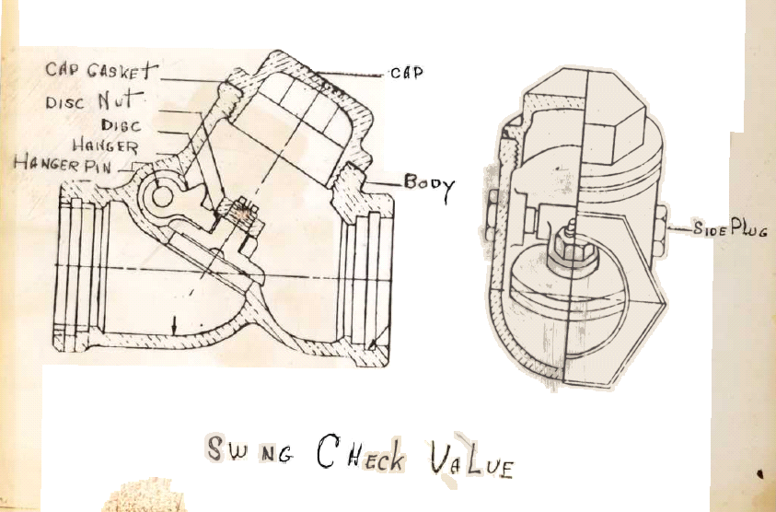
Check Valves
Check Valves
Designed to flow in one direction only
Used for backflow prevention
Swing Check Valve
LO4
Notes:
Check Valves
Flow markings on check valves indicate the flow of the fluid through the valve. The flow direction is shown on the drawing as an arrow.
Flow arrow should be marked on the valve body and the drawing should indicate required orientation.

Slide 28
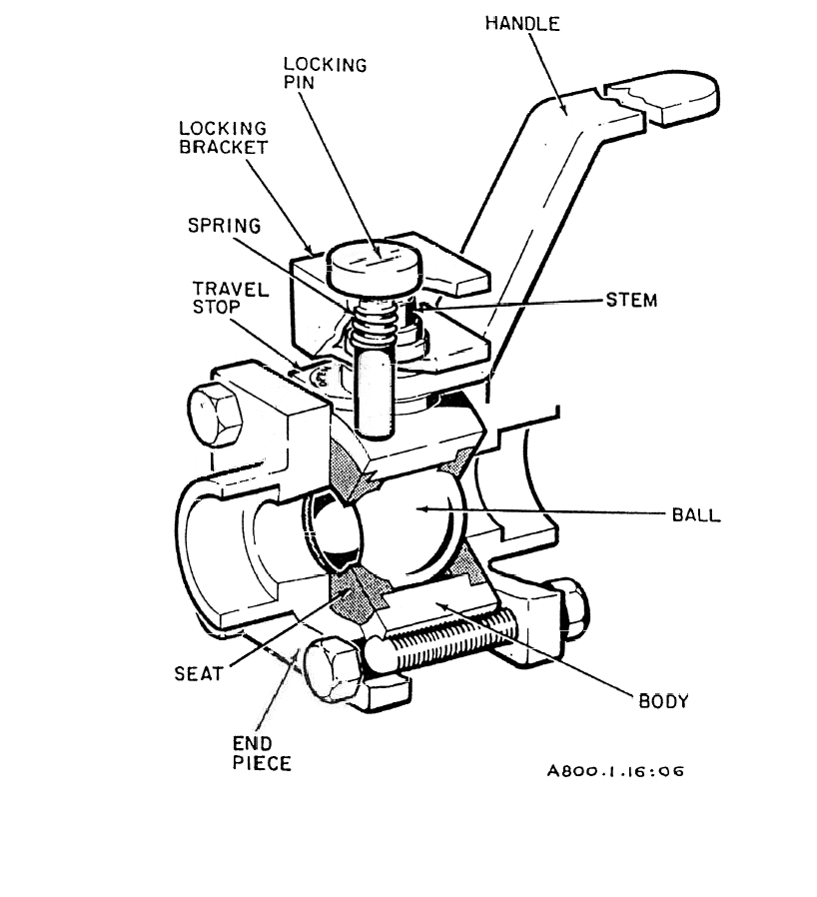
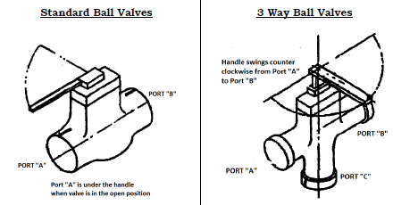
Ball Valves
Ball Valves
System diagrams do not provide bridge wall designation or valve orientation information for ball valves.
Orientation is based on the valve handle position shown on the piping arrangement drawing unless the valve has other asymmetrical features that must also be considered.
When the valve handle is in line with the run of the pipe, the valve is open.
LO4
Notes:
Ball Valves
Animated slide: text boxes and arrow appear on click.
Remind students that if a Ball Valve is installed backwards, there could be interferences that would prevent the valve from closing.
Bridge wall and flow arrow symbols are not applicable to gate valves and ball valves.
Stem orientation and roll angle is shown on construction drawings to provide accessibility for valve operation.
Note: Although ball valves may not contain vendor flow direction information, the orientation for ball valves is dependent on the valve handle position, with port “A” located under the handle when the valve is in the open position.

Slide 29
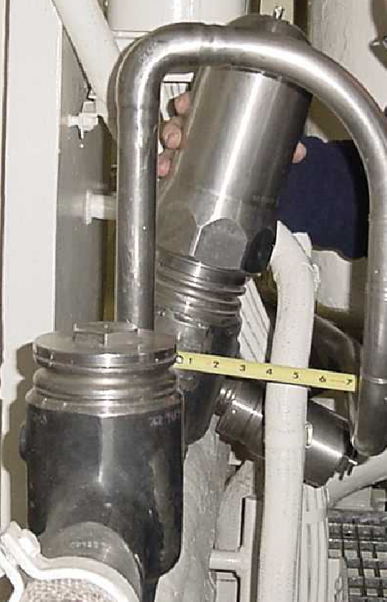
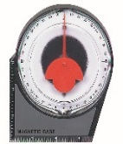
Valve Orientation
Valve Orientation
Stem Orientation/Roll Angle
If a valve does not have a bridge wall mark, do not install and notify your supervisor.
If a drawing does not have a bridge wall mark, do not install and notify engineering.
Check Valve
Upright
Check Roll Angle
LO4
Notes:
Stem Orientation/Roll Angle
The specific stem orientation (roll angle) is provided on the arrangement drawing.
Correct valve orientation
Bridge wall or flow symbol
Stem orientation/roll angle
Verification to drawing requirements
Acceptance of fit-up inspection by NQCI or Trained Trade
Installation Check (IC) inspection by NQCI per NSI 0802

Slide 30
Knowledge Check
Check valves are designed to flow in one direction only.
True
False
LO4

Slide 31
Flex Hose Storage
Flex Hose Storage Requirements
Store hoses away from direct sunlight, sources of heat/sources of ozone.
Store in a dry area with temperatures below 90°.
Protect from damage by wrapping with suitable material.
Store hose up to & including two inches in either straight lengths or coils.
Store hoses greater than two inches in straight lengths.
When coiled, ensure the hose is not bent or kinked below the allowed minimum bend radius.
LO5
Notes:
Storage Requirements
Protect ends of hose or hose assemblies from dirt, debris, and damage with approved cleanliness caps or blanks.
Protect hose by attaching sheet metal cover over sheet plastic, or wrap heavy aluminum foil around the sheet plastic 5 or 6 times. Seal split of sheet metal cover or edge of foil with green tape.

Slide 32
Virginia Class Typical Hose Tag
Virginia Class
Typical Hose Tag
2633-225-01
Manufacturer
Hose Part No.
Hose Mfd Date
AEROQUIP-150901-48 MFD ______
ITEM ____ EB INST _______
When notified of the operational start date of the system, tradesperson inscribes the date (Qtr./Year) in the installation date block.
4/07
32
1/13
NNS
Item No. from list of flexible connectors
Date (Qtr./Year)
Beginning of Service Life
LO5
Notes:
2633-225-01
Example of the detailed requirements for the identification tag.
The tag is installed with the hose at installation.
The EB INST is not inscribed until the hose has begun operation testing. This is considered the start of Service Life.
NNS indicates hose was installed by NGNN.
This date is used in determining the hose’s shelf life.
Shelf Life of Rubber Hoses
The maximum shelf life for rubber hose assemblies is 6 years (24 quarters).
Hose assemblies fabricated from extended shelf life bulk hose shall have a metal tag attached to the assembly which states, “Hose assemblies fabricated from extended shelf life bulk hose shall have a metal tag attached to the assembly stating that shelf life for this hose has been extended to ___ years per ER/DF#___. If the hose has been extended to 10 years, the tag shall also state ‘discard lot after__________.’ “
Shelf life is determined by calculating the elapsed time from the first quarter year after date of manufacture as embossed on the lay line on the hose and ending the quarter year during which system operational test are started.
Rubber hose assemblies that exceed their shelf life shall be reported to the Lead Foreman.

Slide 33
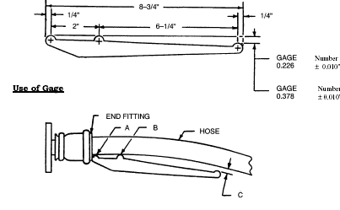
Flex Hose Alignment Gages
Flex Hose Alignment Gages
Gage No. 1 is used at installation
NC170364
MFG. 4Q98 AEROQUIP
Gage No. 2 is used after operational test
NC170364
Go-No-Go Gages
LO5
Notes:
Flex Hose Alignment (Go-No-Go Gages)
NOTE: Instructor review alignment gage requirements (Figure 15).
Gage #1
Used at initial installation acceptance.
Gage #2
Used after system operational test.

Slide 34
Knowledge Check
The shelf life for a flexible hose is 6 years/24 quarters.
True
False
LO5

Slide 35
Test Time
First a brief review…
Write your name, date, and badge number on the test.
Use a black or blue pen or a pencil.
Upon completion, return your test to the instructor for review.
Test-Taking Tips
Take a deep breath and relax.
Read all the questions before you start to answer.
Answer every question as completely as possible.
Check your answers when you’re done.
Notes:
Test Requirements
Testing will be conducted in a classroom environment.
The following test requirements will be invoked:
Study time will be given if necessary, prior to testing.
Talking not allowed, except to the instructor.
Address all questions to the instructor.
Notes and/or handouts are not permitted.
Return test to instructor when completed, and after the instructor has done a quick review of your test, will direct you whether the class is over and if you may leave.

