Slide 1
DMP Mixhead Processor
Electric Boat

Slide 2
DMP Mixhead Processor
Your name
Your background in the painting trade
What you want to learn from this class
A personal “fun fact”

Slide 3
DMP Mixhead Processor
Emergency Exits
Emergency Numbers
Muster Stations
Fire Extinguishers
Automated External Defibrillators (AED)
Cardiopulmonary Resuscitation (CPR)
Other

Slide 4
DMP Mixhead Processor
Class Rules
Class Rules
Place cell phones on silent.
Be respectful of each other.
Participate in class discussions and activities.
Ask questions.
Avoid sidebar conversations.

Slide 5
DMP Mixhead Processor

Slide 6
DMP Mixhead Processor
• OJT Overview
• Personal Protective Equipment
• Personnel Hazards
• What is the DMP Mixhead Processor?
• Components of the DMP Mixhead
• Approved Procedures of the DMP Mixhead

Slide 7
DMP Mixhead Processor
• Minimum Utilities to Operate the DMP Mixhead
• Safe Operation of the Hopper
•Safe Disposal of Hazardous and Nonhazardous
Materials
• Working with DMP Mixhead Valves
• Working with Calibration Samples

Slide 8
DMP Mixhead Processor
Describe the purpose & general information of the DMP Mixhead
Describe the components of the DMP Mixhead
Describe DMP Mixhead principles of operation
Identify the minimum utilities required to operate the DMP Mixhead

Slide 9
DMP Mixhead Processor
Review the safety standards of working in the DMP Mixhead Task
Demonstrate the ability to empty and fill hopper
Demonstrate control methods for hazardous & non-hazardous material disposal

Slide 10
DMP Mixhead Processor
Demonstrate ability to disassemble, clean, and reassemble Mixhead valves (3-Way Valves, Slide Gate, Wave Pump)
Demonstrate the ability to hook up and breakdown material, air and solvent hoses
Demonstrate the ability to assist in taking calibration samples

Slide 11
What is the DMP Mixhead Processor?

Slide 12
DMP Mixhead Processor
Ice Breaker
Share a personal disaster story while on the painting task.
What did you learn?
What would you do differently?

Slide 13
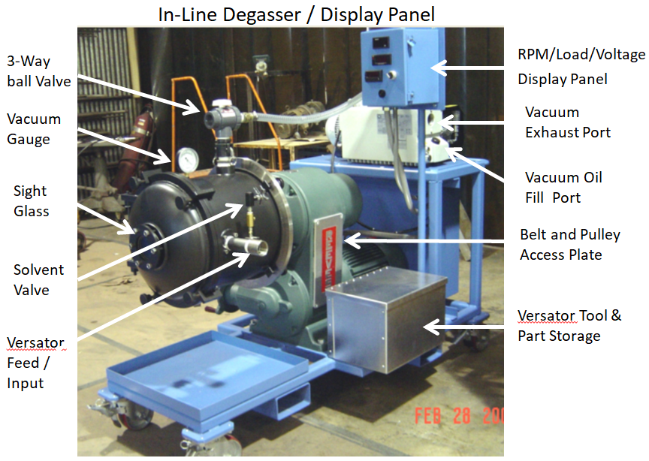
DMP Mixhead Processor
What is the DMP Mixhead Processor?

Slide 14
DMP Mixhead Processor
What is the DMP Mixhead Processor?
Step 1
The mixhead skid meters dilute catalyst from a heated oven and the auger feeds dry filler from hopper to blender, where the catalyst is then combined with A and B material

Slide 15
DMP Mixhead Processor
What is the DMP Mixhead Processor?
Step 2
The blended material is next pumped into the inline degasser with a low shear sine pump for de-aeration

Slide 16
DMP Mixhead Processor
What is the DMP Mixhead Processor?
Step 3
The mixhead skid HMI allows the operator to input mechanical variables such as: dry feeder, sine pump and the blender RPM

Slide 17
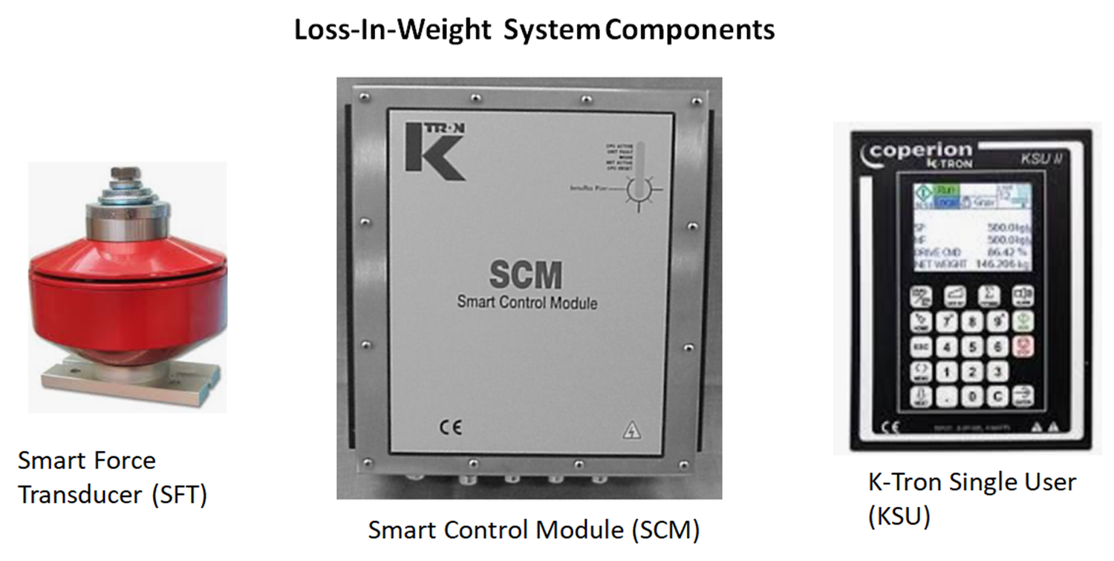
DMP Mixhead Processor

Slide 18
DMP Mixhead Processor
The mixhead skid contains an SLC to provide automated control of various mixhead components such as:
The A, B catalyst
Dump/dispense
Solvent
N2 valves

Slide 19
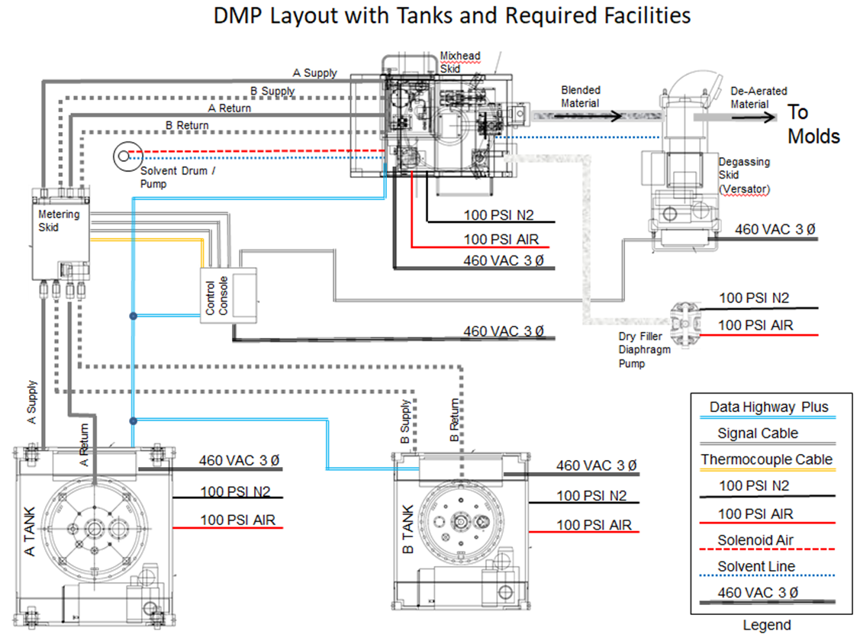
DMP Mixhead Processor
It also allows the operator to monitor:
Flow deviation
Material pressures
Temperatures
Dry filler hopper net weight
Loss in weight

Slide 20
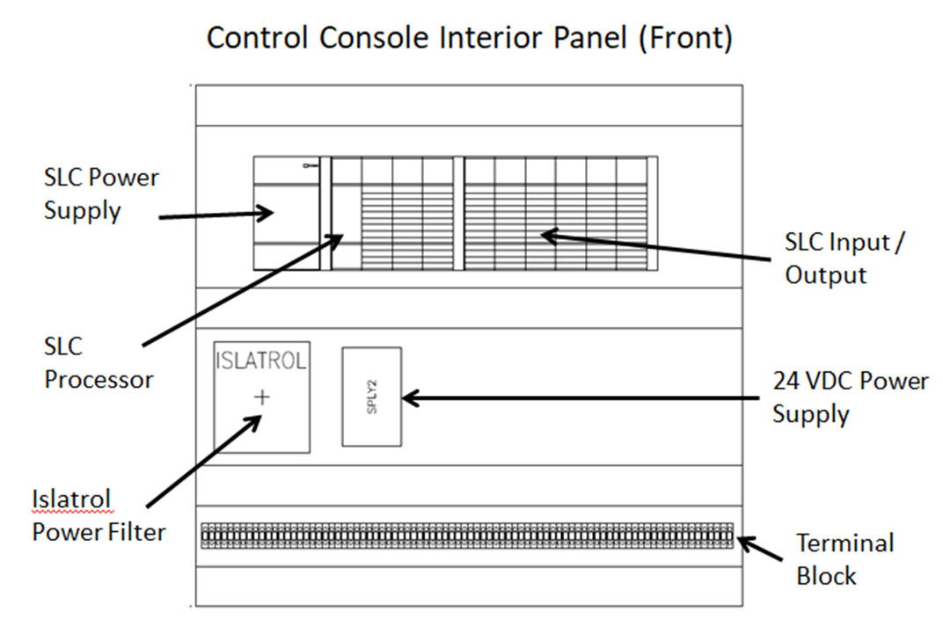
DMP Mixhead Processor
The SLS:
Communicates with the control console, providing status and reacting to changes that occur at the metering skid.
The mixhead skid directs the flow of materials to align with the operating mode that is selected:

Slide 21
DMP Mixhead Processor
The SLS:
Communicates with the control console, providing status and reacting to changes that occur at the metering skid
The mixhead skid directs the flow of materials to align with the operating mode that is selected

Slide 22
DMP Mixhead Processor
Standby:
The A and B material is recirculated back to the return side of the metering skid, where it passes through back-pressure regulating valves, and then back to the return side of the supply tank

Slide 23
DMP Mixhead Processor
Standby continued:
The catalyst is recirculated from its tank in the catalyst oven, through the sample and dispense valves, and back to the catalyst tank through a back-pressure valve

Slide 24
DMP Mixhead Processor
Sample:
The selected A, B, or catalyst material is directed to a sampling port, which is located either on the mixer or at a sampling station located close to the mixer
This is typically a timed operation (0 to sixty seconds) used to check the calibration of the flow meters
Note: Only one stream of material can be “sampled”.
The other streams are recirculating in standby mode.

Slide 25
DMP Mixhead Processor
Activity: Evaluating the DMP Mixhead
What is the DMP Mixhead tool best used for?
Start up
Shutdown
Cleanout
The correct answer is: “The process of combining one or more materials from the oven then feeder to hopper.”
Notes:
Facilitator Note: Demonstrate the three operation modes of the DMP mixhead, before moving into the next topic.

Slide 26
Components of the DMP Mixhead

Slide 27
DMP Mixhead Processor
13
Activity: Guess How Many Parts?
The DMP mixhead has 13 components:
Human machine interface (HMI)
Sequential logic controller (SLC)
Mixer and Catalyst motor servo drives
Sine pump and Dry feeder drives
Notes:
Facilitator Note: During a paired activity, check the learners’ knowledge of “Which part is which on the DMP Mixhead Processor.”
Ask the learners to volunteer their answers in front of the class, and then provide the correct answers as you point out the DMP Mixhead Processor parts one by one.

Slide 28
DMP Mixhead Processor
13
Activity: Guess How Many Parts?
Catalyst flow transmitter
K-Tron loss-in-weight system
Catalyst system
Mixhead assembly
Gate assembly
Dry filler feeder assembly
Sine pump
Solvent system
Dry filler fluidizer system
Notes:
Facilitator Note: During a paired activity, check the learners’ knowledge of “Which part is which on the DMP Mixhead Processor.”
Ask the learners to volunteer their answers in front of the class, and then provide the correct answers as you point out the DMP Mixhead Processor parts one by one.

Slide 29
Approved Procedures of the DMP Mixhead

Slide 30
DMP Mixhead Processor

Slide 31
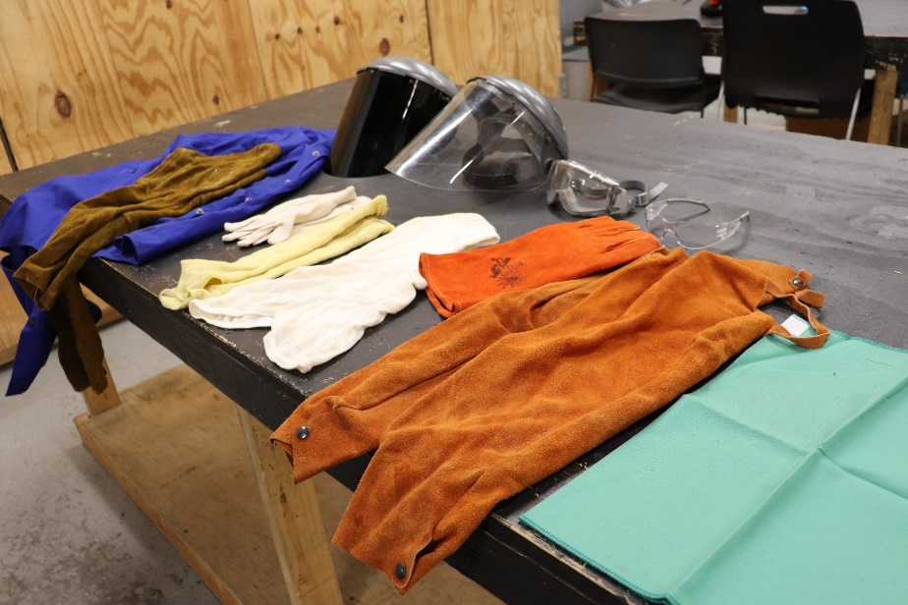
DMP Mixhead Processor
PPE Safety Items
Safety eyeglasses with side shields
Hard hat
Ear plugs or muffs, as necessary
Anti-vibratory Gloves
Face shield
Monoglasses
Safety shoes
Protective footwear
Optional: Prescription safety eyeglasses are available.

Slide 32
DMP Mixhead Processor
Employee safety:
Employee safety:
Employees should never point the spray gun at anyone or at any part of a person’s body, put a hand or fingers over the spray tip, or try to “blow back” paint; this is not an air spray system.
Spray equipment generates very high fluid pressure spray from the gun, potentially causing leaks or rupturing components.
Notes:
*Spray Gun Graphic needed
Remove from FG = Employees should never point the spray gun.

Slide 33
DMP Mixhead Processor
Employee safety:
Employee safety:
Fluid injected or splashed into the eyes or onto the skin can cause serious damage.
This high pressure can inject fluid through the skin and into the body, potentially causing extreme and serious bodily injury, including the need for amputation.
Notes:
*Spray Gun Graphic needed
*Fix the content…replace content

Slide 34
DMP Mixhead Processor
Employees should always follow the “Pressure Relief Procedure”:
If any fluid appears to have penetrated the skin, one must report to the hospital immediately for medical attention.
This situation must not be treated as a simple cut.
Cleaning or removing the spray tip
Servicing any part of the system equipment
Equipment safety devices should be inspected before use to ensure they are in proper working order.
Employees should never try to stop or deflect leaks with a hand or body.
The doctor or nurse must be informed of which fluid was injected.
Notes:
*remove before in the FG… fix the yellow sentence
Move this sentence forward The doctor or nurse must be informed of which fluid was injected.
to 3rd bullet

Slide 35
DMP Mixhead Processor
Grounding safety continued:
To reduce the risk of static sparking these items must be _____:
The pump
The object being sprayed
All other spray equipment being used or located in the spray
Be sure to ground all of the spray equipment.
If every part of the spray system is not properly grounded, sparking may occur, and the system may become hazardous.
Notes:
^missing a word = grounded? Plus bring content up!! From 2 slides down

Slide 36
DMP Mixhead Processor
Grounding safety:
Static electricity safety is created by the flow of fluid through a pump and hose.
Spray gun grounding is achieved through connection to a properly grounded fluid hose and pump.
Only grounded air and fluid hoses with a maximum of 500 feet of combined hose length should be used to ensure grounding continuity.
Notes:
*Flip sentences in FG + add this sentence to top = Static electricity safety is created by the flow of fluid through a pump and hose.

Slide 37
DMP Mixhead Processor
Grounding safety continued:
Solvent pails are used when flushing:
Only metal pails, which are conductive, should be used and placed on a grounded surface.
The pail should not be placed on a non-conductive surface, such as cardboard or paper, which interrupts the grounding continuity.
Notes:
*picture of solvent pails

Slide 38
DMP Mixhead Processor
Grounding safety continued:
Sparking may also occur when the power supply is plugged in, or when you are unplugging the power supply.
Sparks can ignite fumes from solvents OR the fluid being sprayed and cause a fire or explosion, potentially resulting in serious bodily harm.
Power supply cords in the spray area should not be plugged in or unplugged (50 feet in all directions) when there is any chance of igniting fumes still in the air.

Slide 39
DMP Mixhead Processor
Flushing safety:
Before flushing, the entire system and flushing pails must be properly grounded.
The spray tip must be removed from the gun.
The lowest possible fluid pressure must be used,
Firm metal-to-metal contact between the spray gun and the pail must be maintained during flushing to reduce the risk of:
Fluid injection
Static sparking
Splashing
Notes:
If every part of the spray system is not properly grounded, sparking may occur, and the system may become hazardous.
** remove this section from FG
* Picture of flushing process

Slide 40
DMP Mixhead Processor
Spray gun safety:
All spray gun safety devices should be inspected before each use to ensure that they are operating properly.
The gun must never be operated with the trigger guard removed.
Employees should not remove or modify any part of the spray gun, as this can cause a malfunction and result in serious bodily injury.

Slide 41
DMP Mixhead Processor
Spray gun safety:
Extreme caution must be used when cleaning or changing spray tips.
The spray gun diffuser breaks up the spray, reducing the risk of fluid injection when the tip is not installed (The diffuser should be tested regularly.)
Whenever spraying stops, even for a short period, the spray gun safety latch must be set in the closed or off position to ensure the spray gun is inoperable.
Failure to set the safety latch can result in accidental triggering of the spray gun

Slide 42
DMP Mixhead Processor
Spray gun safety:
If the spray tip clogs while spraying, the spray gun safety latch must be engaged immediately.
This process should always be followed before removing the spray tip to clean it.
Never wipe off built-up paint around the spray tip until pressure has been fully relieved, and the spray gun safety latch is engaged.
Notes:
Add middle “this process"

Slide 43
DMP Mixhead Processor
Hose safety:
To prevent a hose rupture, secure all fluid hoses with spring guards on both ends.
All fluid connections must be tightened before each use.
High-pressure fluid can dislodge a loose coupling or allow high-pressure spray to be emitted from the coupling.
Employees should never use a damaged hose.

Slide 44
DMP Mixhead Processor
Hose safety:
A repaired hose cannot safely contain high pressure.
Employees must not try to re-couple the hose or mend it with tape or any other devices.
If any of these conditions exist, the hose must be replaced immediately.
Before each use, the entire hose should be checked for cuts, leaks, abrasions, bulging cover, or damage to the hose couplings.

Slide 45
DMP Mixhead Processor
What is true about spray gun safety?
A. Failure to set the safety latch can result in accidental triggering of the spray gun
B. Whenever spraying stops, even for a short period, the spray gun safety latch must be set in the closed or off position to ensure the spray gun is inoperable
C. All spray gun safety devices should be inspected before each use to ensure that they are operating properly
D. All of the Above

Slide 46
DMP Mixhead Processor
Safely Working with the DMP Mixer
Demonstrate over the next 2 hours the operation of the tool so the learners can successfully operate it when they are OJT. Provide an overview of each safety area, as the learners observe.
Observe compliance of each learner around proper PPE and safety procedures regarding grounding safety of the air and fluid hoses, air guns and solvent pails.
Next, focus on Static Electricity Safety.
Safely flush the pails and operate the functions of the spray gun.
Use the hose effectively and in compliance as the third part of the focus on safety.
Form the learners into small groups and ask them to recall three key takeaways about the safety areas, parts, or processes.
Allow the larger group to correct any errors, to ensure all the learners have reached proficiency.
Notes:
Fix to first person

Slide 47
Minimum Utilities to Operate the DMP Mixhead

Slide 48
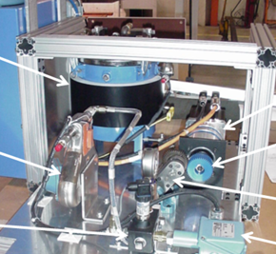
DMP Mixhead Processor
100 PSIG Pneumatic
Air Supply
480v, 100 Amps electrical service
100 PSIG Nitrogen with inline dryer installed
Exhaust Ventilation
Telephone
Temporary/Permanent Lighting
Answer:
11
Eyewash Station
480v, 30 Amps electrical service for Versator
Relative Humidity less than 60%
Heat provided to maintain 70F ambient temperature
Temporary Shower

Slide 49
DMP Mixhead Processor
Activity: What is a Utility?
Demonstrate the 11 main utilities and it’s standards requirements for a worker to safely operate the DMP mixhead processor.
Put the learners into small groups. Then have the learners explore one thing that could go wrong while operating the tool and carefully guide their teammate with some helpful coaching and feedback.
Monitor this process over the course of 1 hour and leave notes per small group.
Notes:
Fix to first person

Slide 50
Safe Operation of the Hopper

Slide 51
DMP Mixhead Processor
Hopper Safety
Ensure all safety precautions have been met.
Have all required documentation prior to working with the tool.
Ensure the rest of the team is in place and briefed (Versator operator, sample taker, radioman, hose operator).
Ensure the materials are in place (A, B, and C materials).
Notes:
*Remove from FG =When safely working on the DMP Mixhead Processor

Slide 52
DMP Mixhead Processor
Hopper Safety
The area must be roped-off with “danger” tape.
Signs identifying requirements to enter work area must be posted.
All personnel in the work area must have safety training.
All personnel in the work area must be medically screened.
All personnel in the work area must be wearing the required PPE.
Notes:
*Remove from FG =When safely working on the DMP Mixhead Processor
Danger signage needed

Slide 53
DMP Mixhead Processor
When safely working on the DMP Mixhead Processor
operational task, make sure:
General ventilation must be operational.
The work area must be free of clutter.
Eyewash stations must be operational.
A shower must be present.
Egress path must be identified.
Spill absorbent material (rags) must be on site.
The fire department must be notified at the beginning and end of a pour.
Notes:
*Workstation imagery needed

Slide 54
DMP Mixhead Processor
Safety Note:
Microspheres should not be stored in the hopper for extended periods of time.
The material will pack and prevent the microspheres from flowing.
If this occurs, the hopper must be emptied, and the material discarded.
Notes:
*Picture of a Microphere needed + Safety Icon

Slide 55
DMP Mixhead Processor
Initially Starting the Hopper:
The microsphere hopper is filled from 6.6 lb. bags of microspheres that have had four to five desiccant bags added to them to mitigate any moisture accumulation.
The speed of operating the hopper includes set points are typically placed at a 30 lbs. /min flow rate.
The speed is increased to 425 RPM once the blended material has made it to the output of the Versator.
The speed of operating the hopper includes set points are typically placed at a 30 lbs. /min flow rate.
Notes:
*Hopper image needed

Slide 56
DMP Mixhead Processor
Insert the microsphere “spear” into the microsphere bag and tighten the collar to get a dust-tight seal.
Ensure the delivery hose is connected with a dust-tight flexible connection to the top of the hopper, and that the hose is supported so that there is no weight from the hose bearing on the hopper.
Ensure the vent filter on the hopper top is clean so that the hopper does not build up pressure.
Blow out the filter with low-pressure air as required.
Ensure the static ground is connected to the diaphragm pump.
Use the “General Scale menu” on the K-Tron display the hopper scale.
Use the N2 valve on the spear to gently “fluff” the microspheres.
Start the Expancel pump (diaphragm pump) and fill the hopper.
Start the hopper fluidizer and let the hopper settle for 15 minutes before starting the dispense cycle.
Notes:
*Change the color of the graphic

Slide 57
DMP Mixhead Processor
Activity: Practicing with the Tool
Learners will now don proper PPE, place them in small groups of 3-5 and asked to demonstrate satisfactory DMP Mixhead Processor techniques and processes in a full multi-day On-The-Job Training and provide supervision.
Operate the DMP mixhead processor. Set the dry feed speed to 100 RPM to avoid compacting the microspheres and causing filler flow issues.
Combine various materials and show the work completed and post-processed to show its before and after states.
Gather one volunteer from each group and instruct the volunteers to demonstrate how to use the DMP Mixhead Processor while wearing the proper PPE and as you provide mentoring.
During each demonstration, encourage the learners to volunteer instructions, best practices, and safety tips.
Notes:
Rewrite in first person

Slide 58
Hazardous and Nonhazardous Materials

Slide 59
DMP Mixhead Processor
Step 1
Coordinate with a Department Environmental Coordinator, the Station G23 Attendant, or ERM to identify the appropriate container for the waste being generated.
Step 2
Label hazardous waste containers properly and before adding waste to the container.
Labeling hazardous waste:

Slide 60
DMP Mixhead Processor
Step 3
The departmental environmental coordinator completes the EB Form 84-00-4763 and labels the container with a hazardous waste label; permanent ink pen is preferred.
Step 4
The departmental environmental coordinator affixes the completed hazardous waste label to an appropriate container
Labeling hazardous waste:

Slide 61
DMP Mixhead Processor
Step 5
Make sure hazardous waste containers are tightly closed at all times, to prevent spills when waste material is not being added or removed.
Step 6
Move hazardous waste containers to the proper station area within 60 calendar days of the accumulation start.
The date is recorded on the hazardous waste label.
Labeling hazardous waste:

Slide 62
DMP Mixhead Processor
Safety Note:
There is no regulated time requirement for the movement of nonhazardous industrial waste to Station G23.
As a best management practice, nonhazardous industrial waste containers should be moved to Station G23 as soon as is practical after the container is full, or as soon as it is determined that the container is no longer needed for the accumulation of waste in that area.

Slide 63
DMP Mixhead Processor
The Requirements for Waste Labeling:

Slide 64
DMP Mixhead Processor
Activity: DMP Scavenger Hunt
Review the handling and identification of hazardous materials and the rules of handling compliance for these materials.
Give the learners an opportunity to demonstrate what they have learned.
Next, create a scavenger hunt around the work area where toxic materials are located or disposed of and discuss safety and which areas to avoid.
If possible, demonstrate actual waste and where it is discarded safely.
Notes:
Fix to first person

Slide 65
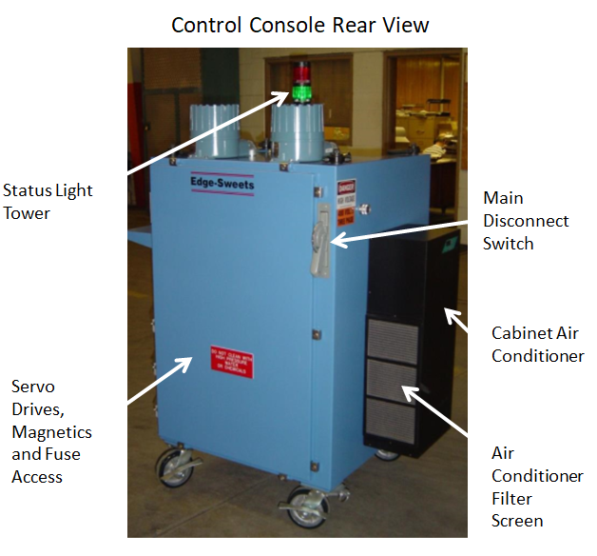
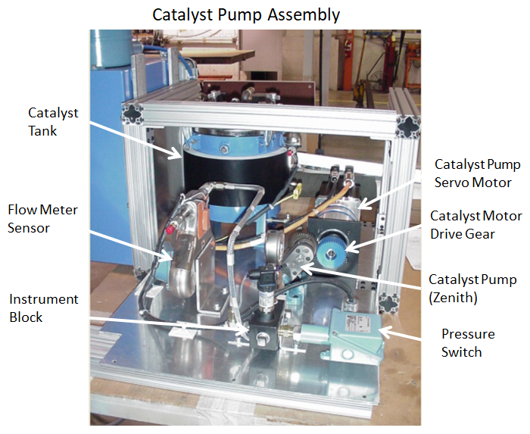
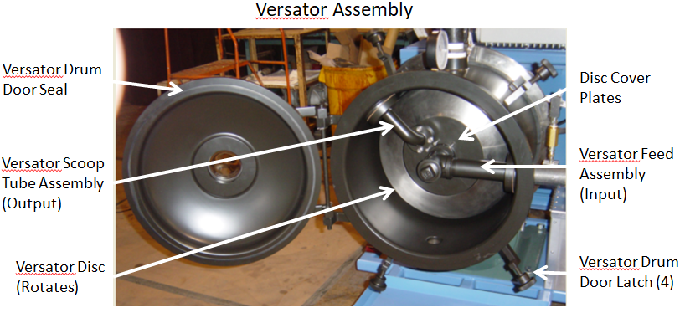
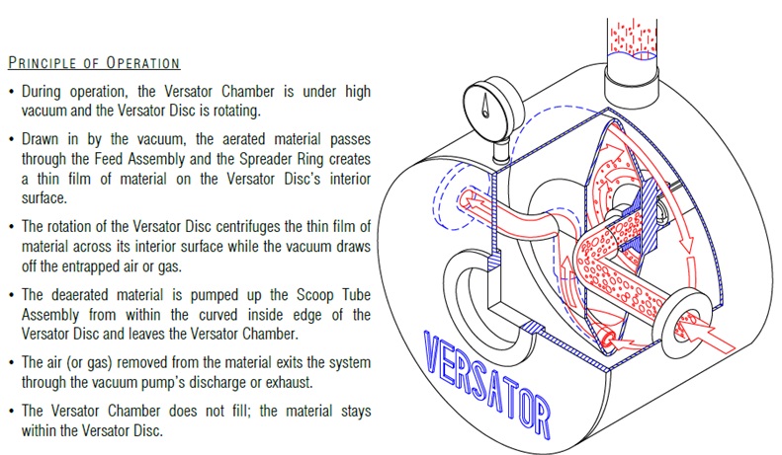
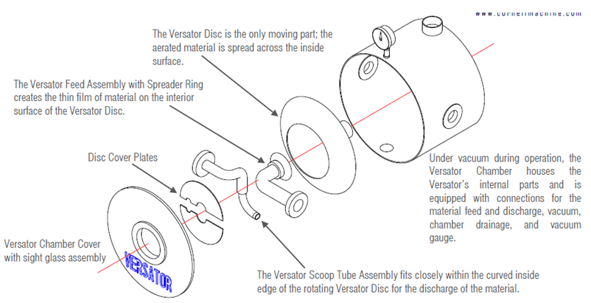
DMP Mixhead Processor
Ice Breaker
Share a personal disaster story while on the painting task.
What did you learn? What would you do differently?

Slide 66
DMP Mixhead Valves

Slide 67
DMP Mixhead Processor
The valves of the DMP Mixhead Processor: Three-way valve
Mount three-way valves to the mixing head directly to the mixing chamber to increase the flow or recirculate the matter back to the tanks.
These valves require periodic maintenance.
Normally, the valve handling the A-side requires more frequent maintenance than the polyol valve, due to the tendency of the A-side (isocyanate) to cure upon itself, forming hardened material in the presence of moisture.

Slide 68
DMP Mixhead Processor
The valves of the DMP Mixhead Processor continued: Three-way valve
It is very important to keep the material tank blankets with nitrogen or dry air to help minimize this effect.
Coat the exposed parts of the valve with petroleum jelly and keeping them clean of liquid isocyanate residue helps facilitate maximum operational life between maintenance periods.
It is very important to seal up the calibration port on the isocyanate valve with petroleum jelly to keep moisture from working its way into the

Slide 69
DMP Mixhead Processor
Orifice Inserts:
The valves are normally shipped with the orifice insert (12) pre-drilled to 1/8” diameter.
The higher the flow rate and the higher the viscosity, the larger the required orifice size must be to keep the pressure drop through the orifice with reasonable operating ranges.
Order orifice inserts with pre-drilled holes or drilled these onsite to the desired orifice size (of approximately for a flow rate of 30 lbs. /min).

Slide 70
DMP Mixhead Processor
Different flow rates may require different orifice sizes;
here is the process:
1. Shut off the air to the machine and disconnect the air lines to the valve actuator.
2. Shut off the pump and close the back-pressure valve.
3. Close the suction line shutoff valve.
4. Disconnect the chemical pressure and return line hoses and cap off or reconnect hoses together creating a valve bypass.
Notes:
Add step numbers 1-16 to FG!

Slide 71
DMP Mixhead Processor
Different flow rates may require different orifice sizes;
here is the process:
- Be sure to have a suitable waste container available to catch any chemical that drains from the hose and from the plumbing lines connected to the valve.
5. Disconnect the thermocouple wire from the thermocouple by the plug.
6. Loosen and remove the two socket head screws that hold the valve to the mixhead and pull the valve free of the mixhead.
7. Tip the valve from side to side over the waste container to drain most of the chemical from the valve. (It may be necessary to remove the plumbing lines attached to the valve.)
Notes:
***Remove the number from FG = Loosen and remove the two socket head screws that hold the valve to the mixhead (23) and pull the valve free of the mixhead.

Slide 72
DMP Mixhead Processor
Different flow rates may require different orifice sizes;
here is the process:
8. Loosen and remove the socket head screws holding the actuator and bracket to the return line adapter and remove the actuator and bracket.
9. Loosen and remove the socket head screws and remove the return line adapter.
10. Remove and clean the two O-rings and the ball seal.(Replacement of the O-rings and ball seal is recommended anytime the entire valve is disassembled.)
11. Loosen and remove the socket cap screws holding the calibrate plate on the rear of the valve.

Slide 73
DMP Mixhead Processor
Different flow rates may require different orifice sizes;
here is the process:
12. Remove the calibration plate. (It can be rotated left to right slightly to better work the part free.)
13. Remove the small round head screws, steam retainer and calibrate pressure adjustment stem.
14. Using a brass or soft metal seal tool, reach into the valve body and pull out the rear ball seal O-ring.

Slide 74
DMP Mixhead Processor
Different flow rates may require different orifice sizes;
here is the process:
15. With an appropriately sized brass or non-metallic rod, push out the valve ball by working the rod in the open port of the return line side of the valve body.
16. The outlet port of the ball must be turned to the recirculate position if it is not in that position already.
Notes:
CAUTION: ** Change to safety notice
Do not use a hard metallic rod or tool to work out the valve ball.
Any scratches on the surface of the ball could damage the ball seals and cause both internal and external leakage of the valve seals.
This would occur after the valve is reassembled.

Slide 75
DMP Mixhead Processor
Safety Note:
Do not use a hard metallic rod or tool to work out the valve ball.
Any scratches on the surface of the ball could damage the ball seals and cause both internal and external leakage of the valve seals.
This would occur after the valve is reassembled.

Slide 76
DMP Mixhead Processor
With the pick tool, reach into the valve body and remove the ball seat.
Remove the small round head screws, stem retainer and pour pressure adjustment stem from the front section of the valve body.
With a brass or non-metallic rod, press out the orifice insert.
With all internal parts removed, use solvent to clean all chemical residue from the valve parts.
Remove any isocyanate buildup from all valve surfaces.
Dry thoroughly and remove any towel lint from internal valve cavities.
Inspect the valve ball for nicks, burrs, or scratches.(Very small scratches can be smoothed with 400-grit emery cloth)
Replace the ball if any larger burrs or scratches are found.
Replace all the O-rings on the valve stems and calibrate plate.
Notes:
Working with Mixhead Valves Process continued: *** Change this title + remove #s

Slide 77
DMP Mixhead Processor
Safety Note:
Apply a light coat of petroleum jelly to lubricate the O-rings and mating surfaces, to make assembly easier and to reduce the likelihood of damage to the O-rings

Slide 78
DMP Mixhead Processor
Press a new orifice insert into the valve body from the rear.
Drill a new orifice hole through the insert.
Turn the valve over and drill a new cross-hole into the orifice insert from the pressure adjustment stem hole.
The hole diameter is .250 inch and must be deep enough for the pressure adjustment stem to completely close off the hole through the orifice insert.
The use of pin vise to drill the holes in the insert is recommended for greater control.
Reinstall the pour pressure adjustment stem and back it out to the fully open position.
Place a new O-ring in the face of the new forward ball seal and slide the ball seal into the valve body cavity O-ring first.
Place the O-ring in petroleum jelly.
Insert a new ball support (8) into the pocket in the valve body cavity.
Notes:
Working with Mixhead Valves Process continued: *** Change this title + remove #s

Slide 79
DMP Mixhead Processor
Face the curved surface of the support toward the interior of the cavity.
Push support into the pocket.
Make sure the it is fully seated.
Notes:
Working with Mixhead Valves Process continued: *** Change this title + remove #s

Slide 80
DMP Mixhead Processor
Slide gate:
The gate assembly is used to control the flow of dry filler material between dispense evolutions.
It is tied directly to dry filler feeder operation.
Secure the unit and tag service/lockout prior to performing maintenance.
To prevent binding, it is important not to overtighten the panels.
Ensure the slide gate is thoroughly wiped and cleaned prior to reassembly.

Slide 81
DMP Mixhead Processor
Safety Note:
Do not use a screwdriver or other prying instrument to separate the cover from the housing.
This can damage the stainless steel.

Slide 82
DMP Mixhead Processor
Wave (sine pump):
You can use a soft hammer to separate the cover from the housing by tapping on the front cover pins, which are located on the outer diameter of the front cover.
Remove the front cover by removing the five wingnuts and sliding the cover off the front cover studs.
You may now remove the front support from the front cover for inspection and cleaning.
Notes:
.

Slide 83
DMP Mixhead Processor
Wave (sine pump) continued:
5. If the support is stainless steel, remove the dynamic face O-ring from the groove.
6. The front cover O-ring may then be removed from the groove in the face of the pump housing.
7. Remove the front liner by pulling with even pressure on both ends.
8. Pulling with uneven pressure can cause the liner to become lodged in the pump housing, making it difficult to remove
Notes:
.

Slide 84
DMP Mixhead Processor
Safety Note: Pumping of high-temperature
Pumping of high-temperature fluids can also make the liners difficult to remove due to thermal expansion.
If the pump has been running at a high temperature, allow it to cool before removing the liner.

Slide 85
DMP Mixhead Processor
The Process Continued
Remove the shaft nut from the shaft.
Wrench flats have been machined on the rear of the shaft to secure the shaft during removal of the nut.
Remove the rear liner.
The rotor O-ring can now be removed from the groove in the shaft nut.
The rotor O-ring can now be removed from the groove in the shaft nut
This requires two hands.
Next the rotor, the scraper gate, and the scraper gate guide can be pulled off the shaft and removed from the pump housing.
This is where the liner/seal housing removal tools are helpful.
Notes:
Maybe put icons here

Slide 86
DMP Mixhead Processor
The Process Continued
Insert the hooked ends of the liner pullers into the slots at on each end of the liner.
The rotor O-ring can then be removed from the groove in the shaft sleeve.
Remove the shaft sleeve (from the seal housing).
Again, apply even pressure on both ends to prevent the liner from lodging in the pump housing.
Remove the lip seal housing and the shaft sleeve.
Insert the pins that are on the pullers into the holes located on the outer diameter of the seal housing.
This is located 180 degrees from each other.
Use the tool to lever the seal out of the pump housing.

Slide 87
DMP Mixhead Processor
The Process Continued
The seal housing O-ring may then be removed from the groove in the pump housing.
If removal of the pump housing is required, remove the housing mounting bolts and housing mounting washers, which connect the pump housing to the power frame.
When removing the pump housing, ensure suitable lifting equipment is available to prevent personal injury or damage to the pump components.
There is a small notch in the bore of the pump housing to facilitate easy removal of the O-ring.

Slide 88
DMP Mixhead Processor
Activity: Practicing with Valves
In the OJT area, demonstrate how to use the valves safely. Select volunteers to teach back information about each valve.
Learners practice their ability to disassemble, clean, and reassemble mixhead valves. This includes three-way valves, slide gate valves, and wave pump valves.
Notes:
Fix to first person

Slide 89
DMP Mixhead Hoses

Slide 90
DMP Mixhead Processor
Activity: Working with the Hoses
Verify the hoses are connected via couplings and latch locks.
Verify the connection is tight and secure.
If possible, during the OJT training, include a record operation supervisor for additional mentoring and support.
Bring the learners to the areas of the shipyard where a DMP Mixhead Processor hose is used.
At the workstation, demonstrate how to use a live DMP Mixhead Processor, and review all the safety requirements and PPE required for the work.
As you do so:
Gauge the skills of each learner.
Supervise each learner as he or she operates the tool.
Before you wrap up the topic, provide a final review of each learner’s skill mastery.
Notes:
Fix in FG

Slide 91
Calibration Samples

Slide 92
DMP Mixhead Processor
Calibration Process Activity
During the OJT, use calibration samples to review proper MIP pour and discuss the differences in calibration.
Demonstrate the MIP pour as the learners observe.
As the learners operate the tool and put on the PPE, point out the valves on the tool, demonstrate how to safety operate the hose, and discuss static safety, and then ask the learners to rank from 1 to 10 how comfortable they feel operating the tool, 1 is “Not well, confident or skilled etc., and 10 is “Ready to go!”
If any learners are struggling, move them into small groups with a leader who has achieved a level of proficiency and who can support and guide the weaker learners who need more practice.
Before wrapping up the course provide final approval of each learner’s skill mastery.

Slide 93
DMP Mixhead Processor
Identify all the parts of the DMP Mixhead Processor
Use proper PPE and safety measures for all hoses, parts, solvent pails, spray guns, valves, and calibration samples.
Consult emergency services in a timely manner.
Operate the tool to conform to the paint trade standards.
Notes:
Delete his from FG =.[Learning Objective 2]

