Slide 1
The Walmart Business Program
Notes:
DLV: Walmart Business (Total Duration: 7.5 hours)
Facilitator Organization:
The training is organized into modules, each with a corresponding set of activities to prepare the learners to assist customers with their Walmart Business accounts. The facilitator will lead the training using a web-conferencing system, Zoom. The learners will complete roleplay activities using the Walmart Business website, CCA, breakout groups, and Litmos course, XT: Walmart Business.
Overview
In this training, the agents will be introduced to the Walmart Business Program for customers.
Do (3 minutes):
Welcome learners to the Walmart Business Program training.
Confirm that they have the Walmart Business Learning Pathway on their Litmos homepage.
Before class ends, they will need to complete two acknowledgments, one for the training, and one for Email and Chat VCC training (if they haven’t completed this already).
Encourage learners to participate in the post-training survey.
Up Next:
Statement of Confidentiality​

Slide 2
Statement of Confidentiality​
All associates are responsible for protecting non-public company information and confidential information about our customers, our process, our strategy, our launch dates, and our performance that has not been disclosed to the public.​
​
Premature disclosure of sensitive information could greatly impact our business results and can put Walmart at a competitive disadvantage. The disclosure or misuse of non-public company information and confidential information may result in disciplinary action up to and including termination of employment.​
​
Examples of non-public company information and confidential information can be found on Walmart One and can be accessed in the search field on the homepage.
Notes:
Statement of Confidentiality​ (2 mins)
Do:
Instruct learners to read our statement of confidentiality
Specify that conversations around Walmart profits and business impacts are not to be shared with customers
Address any questions
Up Next:
Today’s Agenda

Slide 3
Table of Contents
Introduction to Walmart Business
Meet and Greet
Walmart Business Overview
Benefits, Roles, & User Accounts
Contact Principles
Positioning
Walmart Business Scavenger Hunt
Walmart Business Features
Video Walkthrough
Walmart.com Account
Rewards
Navigate CCA
KB Fastest Finder
Walmart Business+ Retention
A.I.R. Retention Model
– Acknowledge, Investigate & Resolve
Scenario Role Plays
Knowledge Check
Walmart Business Trivia
Final Assessment
Wrap Up
Acknowledgement and Survey
Thank you
Today’s Agenda
Notes:
Agenda (2 minutes)
Facilitator Organization:
The training content is broken down into five modules:
Introduction to Walmart Business is about meet and greet, intent of the program, customer benefits, user roles and accounts, recalling contact principles, membership positioning and wrap up with a fun scavenger hunt game.
Walmart Business Features includes a video walkthrough on how to sign up and create an organization, new Walmart.com Account Features including Rewards, CCA Visual Updates for WB Orders, and reviewing KB Articles and Resources
Walmart Business+ Retention will focus on reviewing and practicing the A.I.R. retention model. Roleplay Activities includes putting the knowledge into practice. We will do this by splitting into breakout rooms and roleplaying real-life business customer scenarios.
Knowledge checks include an activity to finish the entire training with a fun activity, and then do a final assessment in Litmos
Wrap up is to clear up any outstanding questions and conclude the training with a Litmos Course Acknowledgment and Survey
Do:
Review the training agenda with the learners, or ask for a volunteer to read the training agenda
Up Next:
Learning Objectives

Slide 4
Learning Objectives
By the end of this training, you will be able to:
Describe the Walmart Business Program, membership options, and benefits to customers
Solve business customer account issues using WM.com, CCA, KB and related resources
Demonstrate retention model toolkit to resolve negative customer experiences and
retain business customers
Notes:
Learner Objectives (3 mins)
By the end of the training, the learners will be able to:
Describe the Walmart Business Program, membership options, and benefits to customers
Solve business customer account issues using WM.com, CCA, KB, and related resources
Follow retention model toolkit to resolve negative customer experiences and retain business customers
Do:
Review the bullets on this slide.
Reinforce that you may not hit EVERY bullet on EVERY interaction, but that by the end of this training you should be able to accomplish all three goals when appropriate for the member.
Answer any questions about the learning objectives.
Up Next:
Meet and Greet

Slide 5
Meet and Greet
Name
# of years of call center experience
Interesting fact about you
Career Goal
Notes:
Meet and Greet (10 mins)
Say:
Before we dive into training today, let’s go around the room and introduce ourselves. When it’s your turn to speak, be sure to unmute and respond to the questions on the screen.
Do:
Allow 10 minutes for the learners to introduce themselves.
Facilitate a casual conversation based on the introductions
Allow all the leaners to unmute and have a conversation with each other in an entire class activity.
Up Next:
Introduction to Walmart Business

Slide 6
Introduction to Walmart Business
Explain the difference between the Walmart Business and Walmart Business+ programs
Recall the benefits and value of Walmart Business and Walmart Business+
Apply contact principles to position the Walmart Business and Walmart Business+ program to customers
Notes:
Introduction to Walmart Business (120 mins)
Learner Objectives (3 mins)
By the end of this module, the learners will be able to:
Explain the difference between the Walmart Business and Walmart Business+ programs
Recall the benefits and value of Walmart Business and Walmart Business+
Apply contact principles to position the Walmart Business and Walmart Business+ program to customers
Do:
Ask for a volunteer to read the bullets on the slide
Answer any questions about the learning objectives.
Up Next:
Walmart Business Benefits

Slide 7
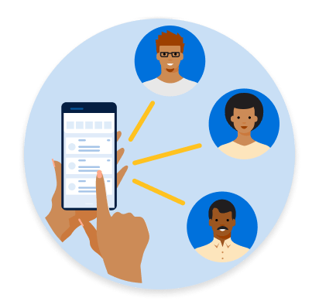
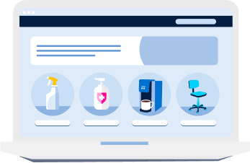
Walmart Business Benefits
KB Article:
What is Walmart Business?
Meet Walmart Business
Cost: Free
What is Walmart Business?
Walmart Business provides a path for consumers to shop for key products for their business needs at our every day low prices.
Walmart Business offers many benefits, including:
Multiple shared account for employees.
A brand and community you know and trust.
A simplified way to save money on your business purchases.
Curated offerings across broad categories.
Notes:
***Contains 4-CLICK ANIMATION***
Walmart Business: Benefits (10 minutes)
Ask:
What do you think the Walmart Business program is?
(Answers vary)
Do:
CLICK to reveal our definition of Walmart Business
Spotlight learners whose answers were close to our definition
CLICK to reveal next animation (KB Article and first line of benefits)
Have learners access the KB article and search for Walmart Business Overview
KB Article: (insert KB Article link)
Ask:
Using the zoom chat, name some of the customer benefits included in Walmart Business.
Allow learners time to answer
Do:
CLICK screen to reveal answers and address them
Say:
Millions of small businesses, nonprofits, and government entities utilize Walmart to purchase items they need to run their organization. With the launch of Walmart Business, we are providing an experience tailored to serve the needs of organizational buyers. This program aims to put more time back in the consumer’s day while continuing to save them money.
The Walmart Business program is free for individuals to sign up and use. Guests can also use the Walmart Business website, but they can only browse, search, and view pricing.
Ask:
Do you think there is a version of the Walmart Business program that has a cost associated with it?
(Answers vary)
Up Next:
Walmart Business+ Benefits

Slide 8
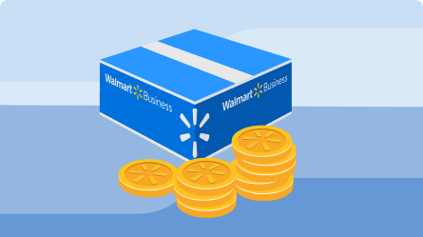
Walmart Business+ Benefits
KB Article:
Walmart Business+
Walmart Business+ makes business ordering, procurement, and inventory management as simple as possible, helping companies save time, money, and reduce hassle.
Price: $98/year
30-Day Free Trial
Note: Only the Primary Admin can begin Business+ Trial
Benefits Include:
Free Shipping, No Order Minimum
Free Delivery from the store
Spend Manager
Cash Back Rewards
Rewards Include:
Get 2% cash back on orders over $250
Earn 5% in cash back every time a subscription item is delivered
Special item-level rewards on popular products
Additional rewards unlocked when purchase thresholds are met
Notes:
***Contains 4-CLICK ANIMATION***
Walmart Business+: Benefits (10 minutes)
Say:
The Walmart Business+ Membership takes the Walmart Business Program to the next level.
Do:
CLICK to reveal KB Article and definition of Walmart Business+
Ask for a volunteer to read the definition
CLICK to reveal next animation including Price
Say:
The cost of the WB+ membership is $98. This is an annual fee and is not available as a monthly membership currently.
Customers can sign up for a 30-Day Free Trial. After the trial, we charge the member $98.
Members receive a confirmation email on the day of sign-up with trial dates, membership plan, and renewal date information.
Ask:
What is the benefit of allowing customers to sign up for a 30-Day free trial?
(Answers Vary)
Possible Guided Response:
This is a great way for members to test most of the benefits of our Walmart Business+ membership before fully committing.
Allows Walmart to collect data on why members attempt to cancel after the 30-Day Free Trial
Say:
Let’s open the Walmart Business+ KB Article and review the benefits.
KB Article: (insert KB Article link)
Ask:
Using the zoom chat, name some of the additional benefits included in WB+.
Allow learners time to answer
Do:
CLICK screen to reveal answers and address them
Say:
WB+ members will enjoy free shipping (excluding oversized and freight items), getting their business supplies as soon as the same day, with preferred delivery times, ability to analyze spending patterns, and they will earn 2% cash back on orders over $250.
Do:
CLICK screen to reveal rewards.
Advise agents to review Rewards listed.
This will be covered later in training.
Up Next:
Walmart Business Program Comparison

Slide 9
Walmart Business Program Comparison
 | Guest | Walmart Business $0 | Business+ $98/year
Curated B2B Assortment Curated catalog of products for businesses
Multi-User Accounts Add users to organization |  | Up to 2 Users | Up to 5 Users
Free Shipping No $35 order minimum required
Free Delivery from store $35 minimum. Restrictions Apply.
Rewards Earn 2% cash back on orders over $250
Spend Analytics Analyze spending patterns
✓
✓
✓
X
✓
✓
X
X
✓
X
X
✓
X
X
✓
X
X
✓
Notes:
Walmart Business: Program Comparison (2 minutes)
Up Next:
Walmart Business: Roles and User Accounts

Slide 10
Walmart Business Roles and User Accounts
KB Article:
Types of Roles
There are three types of roles:
Admin (Primary)
Admin
Buyer
An Admin user will be able to select Role Comparison to review role types for potential users.
Admin (Primary)
Delete Organization
Manage Organization
Manage Users
Manage Shared Payment Methods
Manage Shared Addresses
Manage Tax Exemption
View Organization Purchase History
View Organization Information
Shop Walmart Business
Admin
Manage Users
Manage Shared Payment Methods
Manage Shared Addresses
Manage Tax Exemption
View Organization Purchase History
View Organization Information
Shop Walmart Business
Note: The Primary Admin is the owner of the organization.
Buyer
View Organization Information
Shop Walmart Business
Notes:
Walmart Business: Roles and User Accounts (5 minutes)
Up Next:
Walmart Business: Scavenger Hunt

Slide 11
Activity: Walmart Business Scavenger Hunt
Walmart Business Website: business.walmart.com
Notes:
Activity: Walmart Business Scavenger Hunt (20 minutes)
Up Next:
Recall: Contact Principles

Slide 12
Walmart Business
KB Article:
Walmart Business+
Contact Principles
Recall: Contact Principles
Be Happy
Own It
Be Happy
"[Customer Name], before we get started, I want to thank you for being a Walmart Business+ member. We value your membership and appreciate that you’re a part of the Walmart Business+ family!"
Can-do attitude
Engaged and responsive
Empathetic
Assurance that YOU are the right person to help
Own It
“Can you provide us with more information about why you want to cancel? We would like the chance to provide you as a valued member with a better experience. What made you want to sign up for Walmart Business+?”
Take charge
Identify the core issue
Be confident and control the situation
Reduce It
“As a Walmart Business+ member you’ve saved ($AMOUNT SAVED) and (TIME SAVED) with your membership.”
Reduce the customer’s effort in everything that you do
Review the customer history and highlight the relevant benefits
Persuade the customer with a value statement
Document the contact reason for Walmart Business+
Avoid unnecessary holds and transfers
Resolve It
Reduce It
Resolve It
“Thank you for continuing to be a Walmart Business+ member! Is there anything else I can assist you with today?”
Ensure all issues are resolved
Provide clear and concise benefits information for the customers to make an informed decision to retain their membership
As a last resort, set appropriate expectations on the appeasement offers provided
Notes:
***Contains 4-CLICK ANIMATION***
Contact Principles (10 minutes)
Note: This slide has four animations, one for each plank of our contact principles. Click on each (one at a time) to uncover the breakdown and address learners.
Say: As with all contact types, our Contact Principles help ensure that we focus on the WB member’s needs. Using these principles, we will need to not only make sure our Walmart Business members receive a stellar customer service experience, but also help them understand the value of the Walmart Business memberships.
Do:
All the learners to pull up the KB on Contact principles and Walmart Business+ for reference
Have the learners drop in the chat pod how they would greet a Walmart Business+ member
Do:
CLICK on “Be Happy” to reveal the example greeting and bulleted actions that make up the plank.
Ask learners for examples of what this sounds like.
Reinforce that “being happy” happens throughout the call, not just in the opening statement.
Ask:
Have a volunteer demonstrate what they would say to the customer as part of owning the issue.
Do:
CLICK on “Own It” to reveal the example statement and bulleted actions that make up the plank.
Ask learners for examples of what this sounds like.
Ask learners why OWNING the member’s issue/concerns is so important?
Possible answers to Guide towards:
If the solution to the problem is under your control, ensure that we can assist the customer with resolving the problem
An opportunity to showcase value and overcome a singular negative experience and make it up to our valued Business+ members
Have the learners drop in the chat pod what they would say or do for the customer to ‘reduce it’.
Do:
CLICK on “Reduce It” and reveal the example statement and bulleted actions that make up the plank.
Explain that this plank is all about making it easier on the member.
Possible answers to Guide towards:
Allow the customers to see the value in the membership by looking into their buying behavior and offering them the relevant benefits for saving time and money
Document everything and the actions taken in the unlikely event the issue comes up again, following all the right steps and checking resources, and avoiding unnecessary holds and transfers
Ask learners to speak to any customer service interactions they’ve had where the it seemed like THEY had to advocate for their needs. How did that feel?
Why do you think avoiding unnecessary holds and transfers important?
Do:
Have a volunteer share a closing statement for the call.
CLICK on “Resolve It” to reveal the example closing statement and bulleted actions
Explain that ultimately the most important thing is to retain the customer as a Walmart Business and Walmart Business+ member by solving the member’s issue and addressing all concerns
Up Next:
Positioning

Slide 13
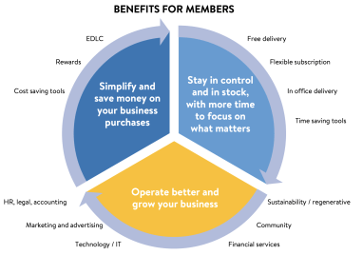
Walmart Business Positioning
“I have been a member of Walmart for a very long time. I have a small business and I need to be able to share my account payment methods with my team and download our Purchase History.
Do you have any recommendations on how I can do that?
Actively listen to customer’s concern
Thank them for their loyalty as one of our most valued customers
Acknowledge the customer’s concern and emotions
Use verbal cues and summarize what they’ve said so they know you’re listening
Ask open-ended questions to understand customer needs and their valued benefits
Review customer’s account information and identify the savings
Establish Your Credibility
Principle of Exchange
Appealing to Emotion
Making a Valid Argument
Positioning Activity
Notes:
Walmart Business: Positioning (50 minutes)
Up Next:
Activity Debrief

Slide 14
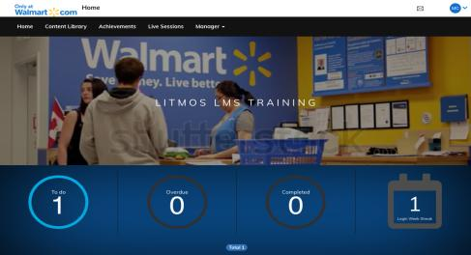
XT: Walmart Business Knowledge Check: Objective Spotlight 1
10 Mins
Finished early?
Explore Walmart Business KB Articles
Notes:
Say: Everyone log into Litmos and open the knowledge check titled XT: Walmart Business – Objective Spotlight 1
Do: *Remind learners to take their time on knowledge checks and to refer to KB as necessary.*
Have agents:
Sign into Walmart.litmos.com
Independently complete knowledge check
Ensure it is in the learning path and called XT: Walmart Business
Say: After you have completed the knowledge check, give me a green check mark. We will have a short discussion about the key takeaways.
Materials: Encourage learners to use KB as necessary.
Do:
Once the group is done with the XT: Walmart Business
Discuss what some of their take-aways are.
Answer any questions they may have.
Transition to: Walmart Business Features
Note:
Will include these questions into Litmos What are 1-2 key benefits of the new program at Walmart? What are the 2 type of business accounts? What are the 3 types of roles a B2B customer may sign up with on the site? What are the 4 contact principles?

Slide 15
Walmart Business Features
Describe the new Walmart account features for Walmart Business customers
Demonstrate Walmart account processes using Walmart.com and Knowledge Base
Solve customer issues related to Walmart Business using CCA workflows
Notes:
Module 2: Walmart Business Features (180 mins)
Learner Objectives (3 mins)
By the end of this module, the learners will be able to:
Describe the new Walmart account features for Walmart Business customers
Demonstrate Walmart account processes using Walmart Business website and Knowledge Base
Solve customer issues related to Walmart Business using CCA workflows
Do:
Ask for a volunteer to read the bullets on the slide
Answer any questions about the learning objectives.
Up Next:
Activity: Video Walkthrough

Slide 16
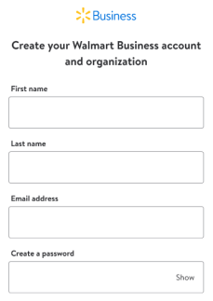
Walmart Business My Account
Notes:
Walmart Business: My Account (30 mins)
Say:
In this activity, we are going to watch a video so you can learn how a customer to sign up for a Walmart Business and Walmart Business Plus account. While watching the video, you will complete a worksheet with blanks to fill in with answers from the video.
At the end, you will have an opportunity to check your answers and ask questions.
Do:
Screen-share XT: Business – My Account Walkthrough Worksheet
Provide the learners 1 minute to access XT: Business – My Account Walkthrough Worksheet in Litmos
Instruct the learners to access and type into worksheet
Allow for the learners to observe video walkthrough, and complete video walkthrough worksheet
Advise to provide a green checkmark reaction once complete
Assist learners in opening worksheet responses once submitted for review
Up Next:
Walmart Business: Tax Exempt

Slide 17
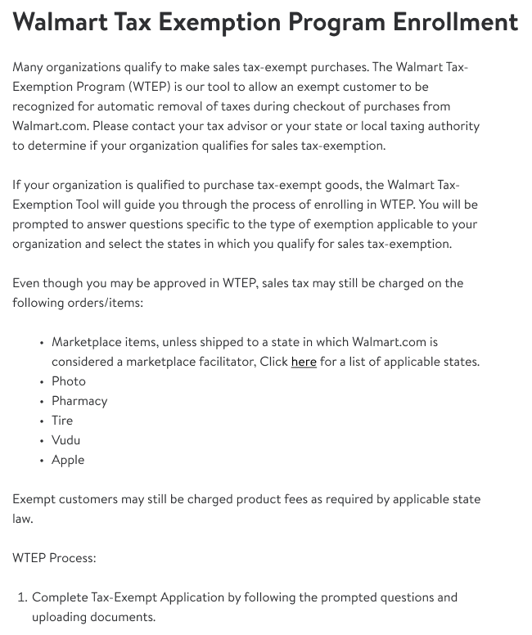
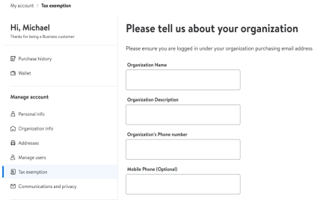
Walmart Business Tax Exempt
Notes:
Walmart Business: Tax Exempt (15 mins)
Up Next:
Walmart Business: Ordering

Slide 18
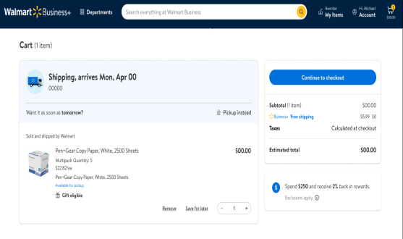
Walmart Business Ordering
Step 1:
Add a Payment Method to Account
Step 2:
After item selection, proceed
to “Check Out”
Step 3:
Review Payment Quantity and Amount
Review Payment Method & Mobile Alerts
Continue to Final Checkout Page
Step 4:
Place Order!
Payment Types:
Credit Card/Debit Card
Gift Card
Notes:
Walmart Business: Ordering (15 mins)
Up Next:
Walmart Business: User Journey/Placing an Order

Slide 19
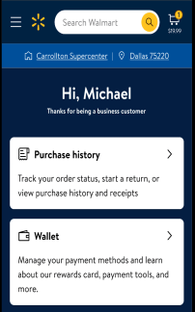
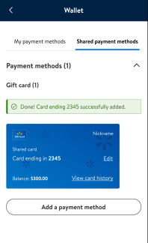
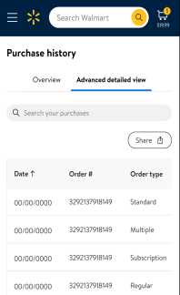
Walmart Business
Payment Method and Purchase History
Notes:
Walmart Business: Payment Method and Purchase History (10 mins)
Up Next:
Rewards

Slide 20
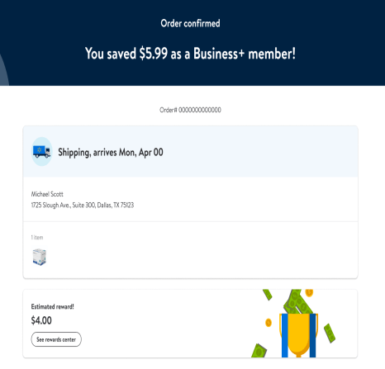
Business+ Rewards
Walmart Business customers can earn 2% cash back on all eligible items if the total is over $250.
Business Rewards can be used as a payment method as soon as they are earned.
No minimum purchase
Each order provides an estimated cash reward earning.
Rewards are earned as soon as order is picked up or delivered.
All users can see rewards earned history.
ONLY Primary Admin can redeem rewards
Notes:
Walmart Business+: Rewards (40 mins)
Up Next:
Navigate CCA

Slide 21
Navigate CCA
Whole Group Activity
Orders are live orders. Do Not select any action buttons
Pull up CCA.
Enter order #WBOrderNumber
Follow along in your own system as the facilitator walks you through the order.
Please ensure you keep pace and don’t go ahead.
1 hour
Notes:
Walmart Business: Navigate CCA (5 mins)
Trainer Note: CCA order numbers used for demonstration of details throughout training should be used with caution. Since you/Agents will be accessing live CCA, please view details only and DO NOT make any changes or adjustments.
Facilitator prep note:
Prior to facilitating the upcoming Action Center sections, please ensure you locate ALL answers to questions based on the order number provided.
Do:
Allow the group to independently review the activity steps.
Say:
Let’s walkthrough a CCA Walmart Business order and point out the different sections each order will contain.
Do not select any action buttons as the order is a live account***
Begin by pulling up CCA
Enter the order number seen on the screen (input order number)
Keep pace with the instructor and don’t go ahead.
The CCA walkthrough is meant to give you overall experience navigating the tool.
Transition to the next Action Center.

Slide 22
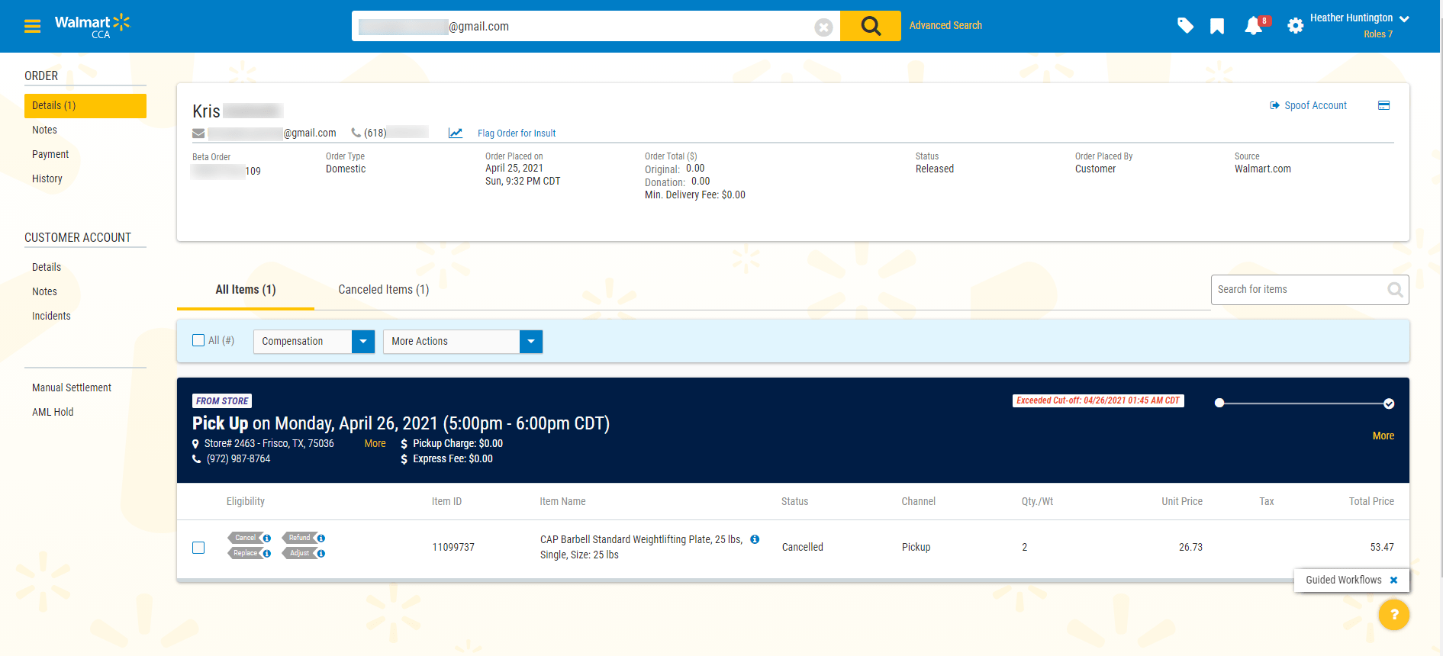
Action Center
Navigate CCA
Customer Account
Notes:
Walmart Business: Customer Account (10 minutes)
Do:
Access CCA Order (input order number)
Share your screen and walkthrough the steps below.
Say:
Now we will explore the Customer Account Info tab
Ask:
What do you see when you click on Details?
This is where you will see all the promo codes the customer received from Walmart.com
You will see the gift cards issued as well.
If the customer is a Walmart + Member
Transition to the next Action Center.

Slide 23
Action Center
Navigate CCA
Payment Tab
Notes:
Walmart Business: Payment Tab (10 minutes)
Do:
Access CCA Order (input order number)
Share your screen and walkthrough the steps below.
Say:
Now we will explore the Payment tab
Ask:
What do you see when you click on Payment?
If the customer is a Walmart Business and Business+ Member
This is where you will see all the promo codes the customer received from Walmart.com
You will see the gift cards issued as well.
* Shared Payment Methods
Up Next:
KB Fastest Finder

Slide 24
KB Fastest Finder
Let’s Explore!
When asked to do so, complete the following:
Open KB Articles:
TBD
TBD
TBD
TBD
TBD
For this activity:
You will be presented a question
Locate its answer quickly and “buzz in”
Be prepared to share your findings
Fastest Finder
Notes:
Activity: KB Fastest Finder (5 mins)
Say:
We are going to switch gears and jump into a KB Fastest Finder.
When asked to do so, you are going to read the following articles.
For this activity,
Spend the next 5 minutes reading the following KB articles
Once the timer is up, I will present you with 5 questions
The first person to Buzz in with their first and last name with the correct answer will be awarded a point
This competition is for bragging rights
Who will be crowned the KB King or Queen
Do:
Have agents locate all 5 articles before moving on
Transition to KB Fastest Finder

Slide 25
KB Fastest Finder
1
2
3
4
5
Notes:
Activity: KB Fastest Finder (10 mins)
Say:
There are 5 articles and 5 questions.
Do:
Call on a volunteer to select a number
Trainer Prep note:
For running the activity, complete the following:
Run as a large group activity.
Select a number, reveal the question and allow the entire group to search.
Set a timer and allow up to 3 minute for their research.
Whichever learner finds the answer first and “buzzes in” will be the one to provide the answer.
Ask that same learner to also direct you where to find the info in the resource, so you can show the group
Allow an additional learner to jump in if the 1st answer offered is incorrect.
Shape/coach responses as/if needed and ensure that all final answers are correct.
Answer any remaining questions the learners may have before moving on.
Transition to KB Fastest Finder Wheel

Slide 26
XT: Walmart Business Knowledge Check: Objective Spotlight 2
10 Mins
Finished early?
Explore Walmart Business KB Articles
Notes:
Say: Everyone log into Litmos and open the knowledge check titled XT: Walmart Business – Objective Spotlight 2
Do: *Remind learners to take their time on knowledge checks and to refer to KB as necessary.*
Have agents:
Sign into Walmart.litmos.com
Independently complete knowledge check
Ensure it is in the learning path and called XT: Walmart Business
Say: After you have completed the knowledge check, give me a green check mark. We will have a short discussion about the key takeaways.
Materials: Encourage learners to use KB as necessary.
Do:
Once the group is done with the XT: Walmart Business
Discuss what some of their take-aways are.
Answer any questions they may have.
Transition to: Walmart Business Retention

Slide 27
Walmart Business+ Retention
Practice Acknowledge, Investigate, and Resolve to overcome membership issues and retain Walmart Business customers
Complete Walmart Business role play activities to apply knowledge learned
Notes:
Module 3: Walmart Business+ Retention (Duration: TBD)
Learner Objectives (3 mins)
By the end of this module, the learners will be able to:
Practice “Acknowledge, Investigate, and Resolve” to overcome membership issues and retain customers
Complete Walmart Business role play activities to apply knowledge learned
Do:
Ask for a volunteer to read the bullets on the slide
Answer any questions about the learning objectives.
Up Next:

Slide 28
The A.I.R. Method
Use A.I.R. (Acknowledge, Investigate, Resolve) model to encourage customer to retain Business+ membership.
Help the customer realize the value of Business+ by giving it a breath of fresh A.I.R.!
Acknowledge
Investigate
Resolve
A.I.R. Model
De-escalation
Notes:
Walmart Business+: A.I.R. Method (60 mins)
Say:
A.I.R. is an acronym that stands for Acknowledge, Investigate, and Resolve.
This model builds on contact principles, but the steps in the A.I.R. model are tailored specifically to handle Business+ membership cancellations.
Customers sometimes contact us wanting to cancel their memberships. As we know, our goal is to create a win-win situation for both our customers and Walmart by saving the Walmart Business memberships.
We need to educate our customers on the different ways that they can realize the potential of saving money with memberships. Our goal is to understand what motivates them, their concerns, and provide them resolutions that work for their lifestyle. We will accomplish this by giving Walmart Business and Walmart Business + a breath of fresh A.I.R. for the customers to see how it can help them.
Up Next:
Retention Model: A.I.R. Step 1: Acknowledge

Slide 29
Retention Toolkit
KB Article: Walmart Business+
Retention Model: A.I.R. Step 1: Acknowledge
Listen to customer’s concern
Thank them for their loyalty as one of our most valued customers
Acknowledge the customer’s concern and emotions
Empathize for a situation outside of our control
Apologize for any poor customer experience
"[Customer Name], before we get started, I want to thank you for being a Business+ member. I understand your concern and I am happy to help!
Acknowledge
Anchor Activity
Spotlight Roleplay
Investigate
What is Empathy vs. Apology?
Anchor Activity
Apology is acknowledging Walmart made a mistake and we’ll make it right.
Empathizing is relating to, and understanding, how a member feels about a situation without just saying “I’m sorry”.
Spotlight Roleplay
Resolve
Anchor Activity
Spotlight Roleplay
Notes:
***Contains 3-CLICK ANIMATION***
Retention Model: A.I.R. Step 1: Acknowledge (20 minutes)
FACILITATOR PREP:
Give attention to timely yet meaningful conversations
Do:
Review the required Acknowledge actions to take when they receive a customer call to cancel membership (Ask for a volunteer)
Explain that this step is to acknowledge the member’s emotion and any past negative experiences that led to them looking to cancel their membership
CLICK to reveal animation (Apology vs. Empathy question)
Ask:
What is the difference between apologizing and empathizing? (allow agents time to respond in the chat or audibly)
Answer:
An apology is acknowledging that Walmart made a mistake and that we’ll make it right. Apologizing for something outside of Walmart’s control or over apologizing can come off as disingenuous. Empathizing is relating to, and understanding, how a member feels about a situation without just saying “I’m sorry”.
Do:
CLICK in the empty space to reveal the answers
Explain that is important to remember not to over apologize or be over empathetic as it can appear to the customer as patronizing
What could happen if we over apologize or over empathize?
Explain that we want to thank Business+ members as our most valued customers to add to the overall customer experience and to ensure the customer we value their membership
CLICK to reveal animation (KB article)
Advise agents to open the KB Article
Review the KB article as a group
Take questions as needed
Review the Avatar statement as an example of what it looks like to acknowledge our Business+ Members and provide empathy at the same time
Transition to activity
Up Next:
Anchor Activity: A.I.R. Step 1: Acknowledge

Slide 30
Retention Toolkit
Anchor Activity: A.I.R. Step 1: Acknowledge
“I understand that you wish to cancel your Business+ membership.”
Acknowledge
Anchor Activity
Let’s Play
“You Tell Me”
Empathy vs. Apology
Show us your best
Empathy or Apology statement!
Spotlight Roleplay
“I’ve already requested the membership be cancelled and it’s not done. Please cancel it.
“I want to cancel this membership. If I still have to pay all these fees and tips, I don’t need it!”
"I want to cancel. Who cares about free delivery when the driver never follows directions!"
Investigate
“I really don’t use this membership. Can you tell me how to cancel?
Anchor Activity
Spotlight Roleplay
Resolve
Anchor Activity
Spotlight Roleplay
Notes:
***Contains ANIMATION and GROUP POLL ACTIVITY***Follow the prompts throughout the "Do" sections.***
Retention Model: A.I.R. Step 1: Acknowledge (25 minutes)
FACILITATOR PREP:
Familiarize yourself with the purpose of the activity
Set up the Empathy vs Apology Poll within Zoom prior to class
Practice Animations and Activities
Give attention to timely yet meaningful conversations
Say:
Let's play “You Tell Me”! I am going to provide you a customer statement…
”You Tell Me” if the agent should respond with empathy or an apology.
To capture your answers, we are going to take a private poll. No one will be able to see individual responses.
You will have a choice between “Empathy” or “Apology”
To assist, you will be able to see the customer statement on my screen and in the poll as I read aloud.
(Take questions if needed)
Do:
Launch your created poll within Zoom
CLICK the blue Let's Play box on your screen to move to the first customer statement
Read Aloud in role as the customer
Continue to click and role play for each statement until all 4 are complete
Allow 3 minutes for the activity (use the poll timer to help)
Show poll results
Review results with the learners (highlight and discuss any differences from the answer key)
Answer Key:
Apology – Poor customer experience due to the membership not being canceled on first request
Empathy – Walmart has not wronged the customer; however, we can understand how the customer may feel
Biggest callout – no wrongdoing by Walmart, we’d use both hats here (customer and agent)
Empathy – Walmart has not wronged the customer according to the statement provided
Apology – Poor customer experience with a driver who represents Walmart.
Say:
Who would like to volunteer and act this out with me? I will be the customer, and you are the agent. I want you to show us your best empathy or apology statement!
(Be prepared to spotlight learners to engage participation)
Do:
Complete all 4 scenarios with a different agent for each one
Highlight strengths and assist with opportunities by offering another suggestion
Thank learners for their participation
Up Next:
Spotlight Practice 1: Acknowledge

Slide 31
Retention Toolkit
Retention Model: A.I.R. Step 2: Investigate
Actively listen to the customer
Use verbal cues and summarize what they’ve said so they know you’re listening
Ask open-ended questions to understand customer needs and their valued benefits
Uncover customer’s buying motivator to help you in crafting an offer
Review customer’s account information and identify the savings
“Do you mind if I ask a few questions to understand the reason for cancellation?”
Acknowledge
Anchor Activity
Spotlight Roleplay
Investigate
Anchor Activity
Spotlight Roleplay
Resolve
Anchor Activity
Spotlight Roleplay
Notes:
Retention Model: A.I.R. Step 2: Investigate (10 minutes)
Do:
Now that the customer is acknowledged, review the required Investigate actions to be taken
Explain that this step is to understand the root cause of the problem and research options
Ask:
Ask for a few volunteers to define “active listening”
Answer to guide participants to:
Active Listening means giving the speaker your full attention and paying attention to both the words they say AND verbal queues like pauses, change in tone, and or sound queues such as a gasp of surprise, a grunt of disapproval, or vocabulary such as “now”, etc.).
Listen to understand
Listen to learn
Obtain as much information as possible
Do:
Explain that open-ended questions are important because they encourage the member to be detailed and specific in explaining their situation, giving us more information to use in forming a solution to their problem.
Review the avatar verbiage statement
Up Next:
Retention Model: A.I.R. Step 2: Investigate

Slide 32
Retention Toolkit
What When WhereWhy Who Does Do
Anchor Activity 2: A.I.R. Step 2: Investigate
Great ways to begin open-ended questioning!
Use customer verbal cues:
Why do you want to cancel your membership?
What line of work are you in?
Was there a particular benefit that grabbed your interest when you signed up for your membership?
How much are you looking to save with your Business+ Membership?
Use CCA Order History and/or Spoofing the Account:
I see you’ve saved $159. Our membership offers 6 benefits, which one have you taken advantage of the most?
Store vs Delivery orders (Free shipping; Free Store Delivery)
I see you shop online with us; how do you feel about free delivery from your store? (Free shipping; Free Store Delivery)
No orders/Little Orders/No grocery orders – Does customer prefer to shop in store? (Scan & Go)
Use Business+ Benefits:
Are you receiving this full package of benefits with any other you have?
You mentioned your line of work, do you drive to work? We have savings on fuel with your Business+ Membership! How much would you say you spend in gas per week at the pump?
As we strive to always be the low-price leader, what do you think about having early access to our most amazing deals, especially with back to school and the holidays coming up?
Let’s practice effective questioning:
Uncovering our customer’s buying motivators along with understanding the customer need and their valued benefits is imperative to saving the membership and assisting you in crafting an offer. The way you ask questions can be the difference between tailoring your offers to fit your customer vs just offering anything.
Use the customer statement and the Business+ account information
We will break into groups of 4-5 and use breakout rooms
Focus on using open-ended questioning to uncover the customers buying motivator
Use the model of What, When, Where, Why, Who, Does, Do
Create 3 open ended questions to help you uncover the customers buying motivator
Use your “Anchor Activity Worksheet: Investigate” in Litmos to take good notes
Be thoughtful and gain as much information as you can
Your group will have 5 minutes
Acknowledge
Anchor Activity
Spotlight Roleplay
Investigate
Anchor Activity
Spotlight Roleplay
Resolve
“I want you to cancel this membership! I’ve been a Walmart customer for a long time and never been, so dissatisfied! I figured in my line of work; this would help me save.
I do not want this membership. Cancel it now.”
Anchor Activity
Spotlight Roleplay
Notes:
***Contains 3 ANIMATIONS and GROUP ACTIVITY***Follow the prompts throughout to guide learners through the activity.***
Retention Model: A.I.R. Step 2: Investigate (30 minutes)
FACILITATOR PREP:
Create breakout rooms prior to class beginning
Your buying motivator is “Member prices on fuel”
Give attention to timely yet meaningful conversations
**Activity**
Say:
Now that you’ve practiced listening to the customers need; uncovering our customer’s buying motivator along with understanding the customer need, and their valued benefits is imperative to saving the membership and assisting you in crafting an offer. The way you ask questions can be the difference between tailoring your offers to fit your customer vs just offering anything.
Using our customer statement shown at the bottom of the screen, and the Business+ account information shown; it will be up to the group to determine the customers buying motivator
Using the customer verbal ques, CCA order history and/or spoofing the account, along with the Business+ Benefits themselves are great starters to developing what questions to ask. We will explore these at the end of the activities
You will be broken up into groups of 4-5 and placed into breakout rooms to work together
Strictly focus on the use of open-ended questioning to uncover the customers buying motivator in this scenario
Use the model of What, When, Where, Why, Who, Does, Do
As a team produce 3 open ended questions to assist you in guessing the customers line of work and how they expected to save
Make note of your questions and select someone to speak for the group
We will come back together, and you will have an opportunity to ask me 3 questions and I will give you an answer
Use your Anchor Activity Worksheet: Investigate in Litmos to note down your questions! You will come back together a little later as we move into the last step of A.I.R. “Resolve” and any questions and answers from this activity can be used to save this Business+ Membership!
Once you are in your breakout rooms, you will have 5 minutes to produce your 3 open-ended questions to ask the Facilitator. Be thoughtful and gain as much information as you can.
Do:
Encourage learners to take a screenshot of the instructions if needed
Answer any questions regarding the activity
Release the class into the breakout rooms
Set a timer if needed for 5 minutes
Rotate breakout rooms to ensure learner engagement and answer any questions
Once time is coming close to ending, announce this to the group
When time is up, pull participants back into the main meeting room
Pulse check learner engagement
Do:
Allow groups to volunteer to go first or you can select groups one by one
Answer each question as the question comes in WITHOUT revealing the buying motivator
Possible Group Questions:
Customer verbal cues:
Why do you want to cancel your membership?
What line of work are you in?
Was there a particular benefit that grabbed your interest in the membership?
How much are you looking to save with your Business+ Membership?
CCA Order History and Spoofing the account:
I see you’ve saved $159. Our membership offers 6 benefits, which one have you taken advantage of the most?
Store vs Delivery orders (Free shipping; Free Store Delivery)
I see you shop online with us; how do you feel about free delivery from your store? (Free shipping; Free Store Delivery)
No orders/Little Orders/No grocery orders – Does customer prefer to shop in store? (Scan & Go)
Business+ Benefits:
Are you receiving this full package of benefits with any other memberships you have?
You mentioned your line of work, do you drive to work? We have savings on fuel with your Business+ Membership! How much would you say you spend in gas per week at the pump?
As we strive to always be the low-price leader, what do you think about having early access to our most amazing deals, especially with back to school and the holidays coming up?
Do
Help the learners retrieve their worksheets
Return to the Litmos Roleplay course from the completed worksheet by clicking the Exit button on the top right toolbar
On the Modules tab of the Litmos Roleplay course, right-click Results tab on the right-end of Roleplay Worksheet to open in a new tab
CLICK on the screen to reveal our list of possible answers
Review responses and call out groups with responses close to our answer key
Discuss the importance of these questions and make additional call outs
Create meaningful dialogue where needed
Remind learners to save these questions and answers
Say:
As we continue through training, the information from this activity will be used in a “Resolve” activity. Before moving to resolve, let’s put all the steps we just learned from investigate a practice by role playing.
Up Next:
Spotlight Practice 1: Investigate

Slide 33
Retention Toolkit
Retention Model: A.I.R. Step 3: Resolve
Resolve any existing incidents – many cancellation requests result from a poor customer experience, OWN IT.
Look for alternatives that were not originally offered as a solution and provide options to match the customer needs
Persuade to positively influence and retain customers through engagement, connection, and creative problem-solving
Position a value statement
Do what’s best for the customer – always remind them that they are a valued Business+ member, and for that reason we can go above and beyond to assist
Document the incident including the details of the conversation, the steps you took to resolve the member’s issue, and disposition the ticket, business-as-usual.
“Because you’re a valued member, I have a few options for you…”
Acknowledge
Anchor Activity
Spotlight Roleplay
Investigate
Anchor Activity
Spotlight Roleplay
Resolve
Anchor Activity
Spotlight Roleplay
Notes:
Retention Model: A.I.R. Step 3: Resolve (5 minutes)
Do:
As a final step, review the required Resolve actions to be taken
Explain that this step is to tailor our offers to fit their legitimate needs and to solve any outstanding issues of the customer
Say:
We use this opportunity to position a value statement that explains to the customer why retaining the Business+ membership can be helpful to them
Do not throw out random Business+ benefits to save. This will come off as disingenuous – we always want to focus on doing what’s best for the Business+ member.
Do:
Review the avatar verbiage statement
Up Next:
Retention Model: A.I.R. Step 3: Resolve: Principles of Persuasion

Slide 34
Retention Toolkit
Retention Model: A.I.R. Step 3: Resolve
Do what’s best for the customer: Escalate
Acknowledge
Follow your team's escalation process in the unlikely event that a member:
requests a refund outside of the policy
refuses further assistance and requests a supervisor
“I’m so sorry I couldn’t resolve your concerns myself. If you’ll hold just a moment, I’ll get a supervisor on the line for you.”
Anchor Activity
Spotlight Roleplay
Investigate
Anchor Activity
Spotlight Roleplay
Resolve
Anchor Activity
Spotlight Roleplay
Notes:
Retention Model: A.I.R. Step 3: Resolve (3 minutes)
Do:
Review the slide with the learners
Up Next:
Spotlight Practice 1: Resolve

Slide 35
Retention Toolkit
Recall: De-escalation Model
If a customer is escalated, you must first work to de-escalate them before you can move into a retention conversation. Address the initial reason for the call first.
Upset
Confused
Make
Small Inquiries
It’s Not Personal
Listen Actively
Empathize and
Apologize
Solution is Offered
Stay
Calm
Contact Principles
Persistent
De-escalation
Notes:
Recall: De-escalation Model (25 minutes)
Note:
This slide has a 3-click animation. Don’t click until directed.
When asking for learner responses, ask them to phrase it as if they were speaking to a member.
If necessary, start a mini-roleplay pretending to be the distressed Business+ member.
Do:
Reinforce that if a customer is escalated, you must first work to de-escalate them before you can move into a retention conversation. Address the initial reason for the call first.
Ask:
What are the types of customer moods that lead to difficult conversations?
Answers to guide towards:
There are three “member types”: upset, confused, persistent
Do:
CLICK to reveal the member types
Say:
There are times we deal with difficult situations. We must attempt to de-escalate the situation, by speaking clearly and being patient. These situations will likely influence the member's mood, and how they respond to you.
Upset members will let you know they aren’t happy with their experience and may tell you that they would rather speak to a manager rather than speak with you.
Ask:
How would you support an upset member who wants to cancel membership because his account was charged without his consent, and attempt to de-escalate them? Paraphrase your response as if you are speaking to a member.
Answers to guide towards:
Do: Give the member confidence that you are there to help
Don't: Don't take it personally, they don't know you and you don't know them.
Say:
A confused member is unsure what is going on and what to do. They are skeptical about your solution and might tell you that it didn’t work last time. They are busy or distracted and might not be paying close attention to you.
Ask:
How would you support a confused member who wants to cancel membership because she pays a fee for every delivery, and attempt to de-escalate them? Paraphrase your response as if you are speaking to a member.
Answers to guide towards:
Do: Paraphrase what the caller is saying to ensure that you understand the situation.
Don't: Do not raise your voice or adopt a tone that could sound irritated or impatient.
Say:
A persistent member likes to talk and be listened too. They will interrupt rather than listen to what is being said. They are direct and won’t have a problem telling you if they believe something is wrong. They do not like to waste time and demand immediate action.
Ask:
How would you support a persistent member, and attempt to de-escalate them?
Answers to guide towards:
Do: Stick to the point and focus on solutions.
Don't: Don't be afraid to speak to your manager or other departments in search of a solution for the customer.
Say:
An escalated customer service situation usually means one of three things:
The member didn't accept the associate's word as the final solution
The member thinks it's faster to go “to the top”
The member doesn't feel like everything possible is being done to help
Say: Fortunately, Walmart Customer Care has created an easy tool for you to remember when you have those challenging interactions.
Do:
Click to reveal the SMILES acronym
Say:
SMILES is an acronym, an easily repeatable framework for de-escalating heightened customer service situations, and for maintaining focus on solving member issues.
Ask: Does anyone remember what the acronym stands for?
Answer to guide to:
Stay Calm
Make Small Inquiries
It’s Not Personal
Listen Actively
Empathize & Apologize
Solution is Offered
Say:
Members can sense when you are getting upset, so it is essential to Stay Calm during an escalated contact.
Ask:
How would you support a customer in a calm manner? Paraphrase your response as if you are speaking to a member.
Answers to guide towards:
Smile as you speak - you can really hear a smile over the phone!
Focus on providing correct information and resolving the concern to the best of your ability.
Say:
Make small enquiries to uncover the root cause of the escalation.
Ask:
How would you support a customer by making small inquiries? Paraphrase your response as if you are speaking to a member.
Answer to guide to: Use different types of questions to serve different purposes:
Probing Questions - useful for gaining clarification and additional information.
Open-Ended - require more thought to answer and create a wider discussion
Close-Ended - require a simple, often just a yes or no, answer. Good for gaining agreement and getting specific information.
Say:
Remember that it’s not personal. A member is upset by the situation, or Walmart as a whole - not specifically you.
Ask:
How would you support a customer by treating them kindly? Paraphrase your response as if you are speaking to a member.
Answer to guide to:
Put yourself in the members shoes and treat them as you would want to be treated if the situation were reversed.
Focus on resolving the issue.
You never know what they might be going through outside of your interaction. Be kind!
Say:
Active Listening means giving the speaker your full attention.
Listen to understand
Listen to learn
Obtain as much information as possible
Ask:
How would you support a customer through active listening?
Answer to guide to: Paying attention to both the words they say AND verbal queues like pauses, change in tone, and paralinguistics (a gasp of surprise, a tut of disapproval, etc.).
Say:
Empathizing means showing compassion for, and relating to, the situation. This means putting yourself in the member's shoes and letting them know you understand how they feel.
Apologizing means expressing regret for an action or situation. Apologizing should be reserved for when something has gone wrong - don't just apologize to do it or it may come off as insincere!
Ask:
How would you support a customer with empathy and apology? Paraphrase your response as if you are speaking to a member.
Say:
The intent here is to understand the problem, analyze it, and produce a list of possible solutions that will work best for the member. The work you've done to SMILE will lead you to the right Solution!
Ask:
How would you support a with a solution? Paraphrase your response as if you are speaking to a member.

Slide 36
Retention Toolkit
Recall: De-escalation Model
What are the do’s and don’ts of handling a difficult conversation?
Take a deep breath. Remember the member is not angry at you personally, just the situation or problem.
Think carefully and speak calmly. If the member is yelling, speak quietly so they must be quieter to hear you.
Focus on facts, not emotions.
Do not react and lose your temper. If both parties are angry, nothing will be resolved.
Do not raise your voice or adopt a tone that could sound irritated or impatient.
Paraphrase what the caller is saying to ensure that you understand the situation.
Empathize without criticizing the company or team involved.
If the company is at fault, take accountability and apologize.
Do not be defensive, aggressive, or abrupt.
Do not interrupt or try to apply logic. Let them vent.
Empower the caller by offering solutions and alternatives so they feel like they are a part of the solution.
Be business-like and deal with the matter as quickly as possible.
Let the member know the consequences, or outcomes, calmly and objectively.
Do not place blame on anyone – yourself, the caller, or the company.
Do not make excuses, always stick to the facts.
Contact Principles
De-escalation
Notes:
Recall: De-escalation Model (15 minutes)
Note:
This slide has 15 animations, one for each plank
Click on the plank one at a time to reveal when the learner’s response matches the text behind the plank for de-escalation do’s and don’ts
Facilitate discussions to address each point
Ask:
What are some of the Do’s and Don’ts of de-escalation?
Answer to guide towards:
Do’s:
(Top Row, Left) Take a deep breath. Remember the member is not angry at you personally, just the situation or problem.
(Top Row, Center) Think carefully and speak calmly. If the member is yelling, speak quietly so they must be quieter to hear you.
(Top Row, Right) Focus on facts, not emotions.
(Middle Row, Left) Paraphrase what the caller is saying to ensure that you understand the situation.
(Middle Row, Center) Empathize without criticizing the company or team involved.
(Middle Row, Right) If the company is at fault, take accountability and apologize.
(Bottom Row, Left) Empower the caller by offering solutions and alternatives so they feel like they are a part of the solution.
(Bottom Row, Center) Be business-like and deal with the matter as quickly as possible.
(Bottom Row, Right) Let the member know the consequences, or outcomes, calmly and objectively.
Don’ts
(Top Row, Left) Do not react and lose your temper. If both parties are angry, nothing will be resolved.
(Top Row, Right) Do not raise your voice or adopt a tone that could sound irritated or impatient.
(Middle Row, Left) Do not be defensive, aggressive, or abrupt.
(Middle Row, Right) Do not interrupt or try to apply logic. Let them vent.
(Bottom Row, Left) Do not place blame on anyone – yourself, the caller, or the company.
(Bottom Row, Right) Do not make excuses, always stick to the facts.

Slide 37
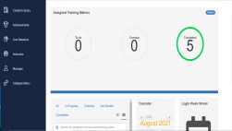
Roleplay Activity
Business+ Membership Retention
Use A.I.R. (Acknowledge, Investigate, Resolve) model to persuade customer to retain Business+ membership.
What you will need:
Access to Business+ KB articles
Litmos Roleplay Job Aid
Litmos Roleplay Customer or Agent Guide
Litmos Roleplay Worksheet
Notes:
Roleplay Activity (50 minutes)
LAUNCH:
Say:
Role playing allows us to practice in a safe environment with our peers before we use our skills in the real world
This roleplay activity will be like what we practiced during the A.I.R. lessons in the earlier sections of this training, except that you will split into groups and act as customer and agent
Let’s pull the instructions from Litmos
EXPLAIN:
Navigate:
Screen-share Litmos Roleplay Instructions
Instruct:
Open Litmos Roleplay Instructions
Have 1 minute to open the instructions
Notify in the chat pod when complete
ACT:
Do:
Allow 1 minute for the learners to open Litmos Roleplay Instructions
Notify in the chat pod when complete
EXPLAIN:
Do:
Review the roleplay instructions on Litmos course with the learners
Say:
Make sure to roleplay professionally throughout the conversation.
Demonstrate:
Give a walk-through of the roleplay documents before the learners begin:
Required KB articles
Litmos Roleplay Job Aid for Business+ Membership Retention toolkit reference
Litmos Roleplay Agent Guide or Customer Guide for scenarios 1, 2, and 3 (Scenarios 4 and 5 are completed by the T1 chat agents on Day 2)
Roleplay worksheet reflection questions
Click Next Question to progress through the worksheet
Click Next to review the responses
Click Complete to submit the worksheet
Ask:
What questions do you have? Answers vary
ACT:
Do:
Allow 45 minutes for the learners to complete the roleplays and reflection questions
Manage the breakout rooms:
Open the breakout rooms in groups of 3 learners
Allow the learners to:
Join their breakout rooms
Work with their groups to complete the roleplay activity
Monitor the breakout groups by making rotational visits
Provide suggestions when a learner calls for help
Close the breakout rooms when the time is up
Up Next:
Roleplay Activity Debrief

Slide 38
Roleplay Activity Debrief
Business+ Membership Retention
Notes:
Roleplay Activity Debrief (10 minutes)
EXPLAIN:
Say:
We will now open the completed worksheets to review them during roleplay debrief.
Navigate:
Screen-share Litmos course
Instruct:
Return to the Litmos course
Have 1 minute to open the worksheet responses for debrief
Notify in the chat pod when complete
Demonstrate:
How to access the Roleplay Worksheet responses:
Click EXIT on the top right toolbar to return to the course page
On the Modules tab of the Litmos course, right-click RESULTS tab on the right-end of each Roleplay Worksheet module to open them on new tabs
Open all the three worksheets
ACT:
Do:
Allow 1 minute for the learners to:
Open all three Roleplay Worksheet responses
Notify in the chat pod when complete
Prepare the learners for debrief by encouraging them to:
Have an open discussion for the questions below
Refer to their completed worksheets to respond
DEBRIEF:
Ask:
Describe your experience as an agent.
What strengths did you identify in your roleplay?
How can you make your conversations more effective?
What were some of the questioning techniques that you used to know your customer? Follow-up: How did you match them with the benefits?
What were some positive key verbiage that your partner used to de-escalate the issue of the customer.
What did your partner’s value statement sound like?
Were you successful in persuading the customer to stay? If so, what did that sound like?
What are the key takeaways from this roleplay activity?
What questions do you have?
Up Next:
Acknowledgement and Survey

Slide 39
Activity: Walmart Business Trivia
Notes:
Activity: Walmart Business Trivia (20 minutes)
Up Next:
Objective Spotlight 3

Slide 40
XT: Walmart Business Knowledge Check: Objective Spotlight 3
20 Mins
Finished early?
Explore Walmart Business KB Articles
Notes:
Say: Everyone log into Litmos and open the knowledge check titled XT: Walmart Business – Objective Spotlight 3
Do: *Remind learners to take their time on knowledge checks and to refer to KB as necessary.*
Have agents:
Sign into Walmart.litmos.com
Independently complete knowledge check
Ensure it is in the learning path and called XT: Walmart Business
Say: After you have completed the knowledge check, give me a green check mark. We will have a short discussion about the key takeaways.
Materials: Encourage learners to use KB as necessary.
Do:
Once the group is done with the XT: Walmart Business
Discuss what some of their take-aways are.
Answer any questions they may have.
Transition to: Walmart Business Retention

Slide 41
Wrap Up
Notes:
Say:
Let’s Wrap Up

Slide 42
Walmart Business Acknowledgement and Survey
Notes:
Navigate:
Screen-share the Visual Anchor Slide titled “Acknowledgement and Survey”
Say:
We are almost done here today. Great job on completing your training on Walmart and Walmart Business +. Before we wrap up, we require all our learners to acknowledge that they have successfully received and completed the training requirements by providing an eSignature.
Followed by that, we request you to complete a brief survey as we rely on your feedback to improve our future training.
Do:
Guide the learners to click on the yellow hamburger menu on the top left toolbar and select “Acknowledgement”
When done, move on to Post Training Survey by clicking on the top right toolbar
When finally done, exit the module
Allow the learners 5 minutes to complete the following:
Acknowledgment
Post Training Survey
Share a green checkmark reaction on Zoom when complete
Clear the Zoom reactions when ready to move on
Ask:
What questions do you have?
Answers vary

Slide 43
Thank you!
Notes:
Say:
Congratulations! That is our course! Thank you for being part of our new launch of the Walmart Business and the Walmart Business+ Program and the front line of customer service and support success for this new initiative!

